Slide 1


Slide 2
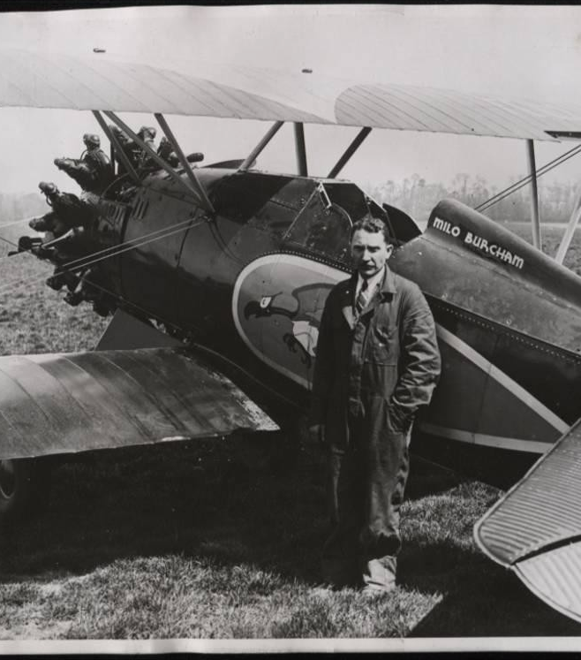
Sabotage, Secrets and Spylanes
An Abbreviated, Slightly Twisted, Opinionated, Not Necessarily 100% Accurate History of Agile.
https://github.com/ericburcham/sabotage-secrets-and-spyplanes

Slide 3
Introduction
Where I tell you what I’m going to tell you.

Slide 4

Obligatory Presenter Slides: Eric Burcham
Coding for a living since 1993.
Agile since before “Agile” was a thing.
Embracing change since 1999.
Extreme Programming All the Way, Baby!

Slide 5
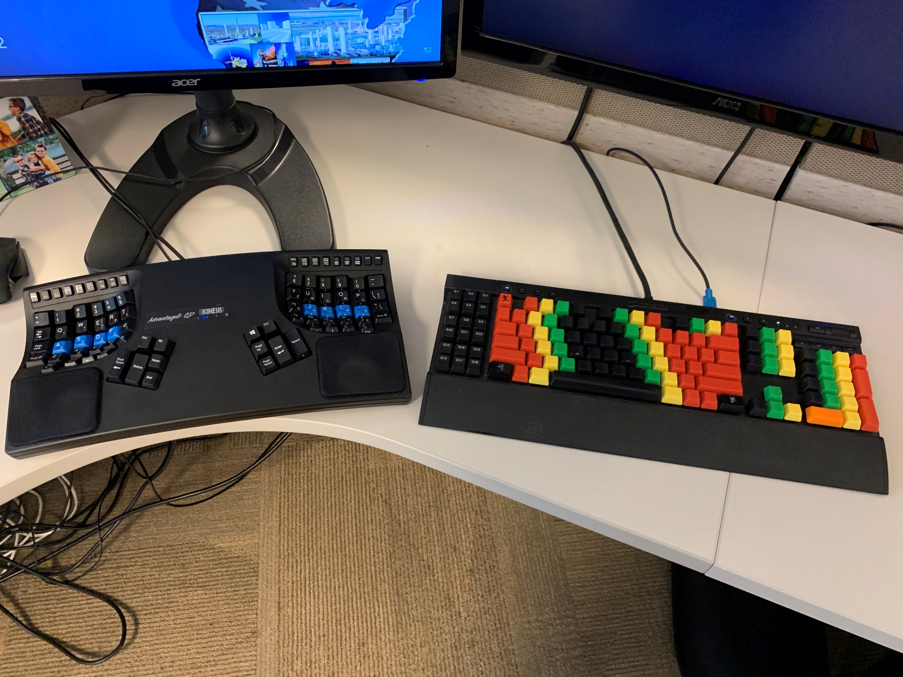
Obligatory Presenter Slides: Eric Burcham
I only pair program with Rastafarians who can touch type.
You thought I was kidding. That’s cute:

Slide 6
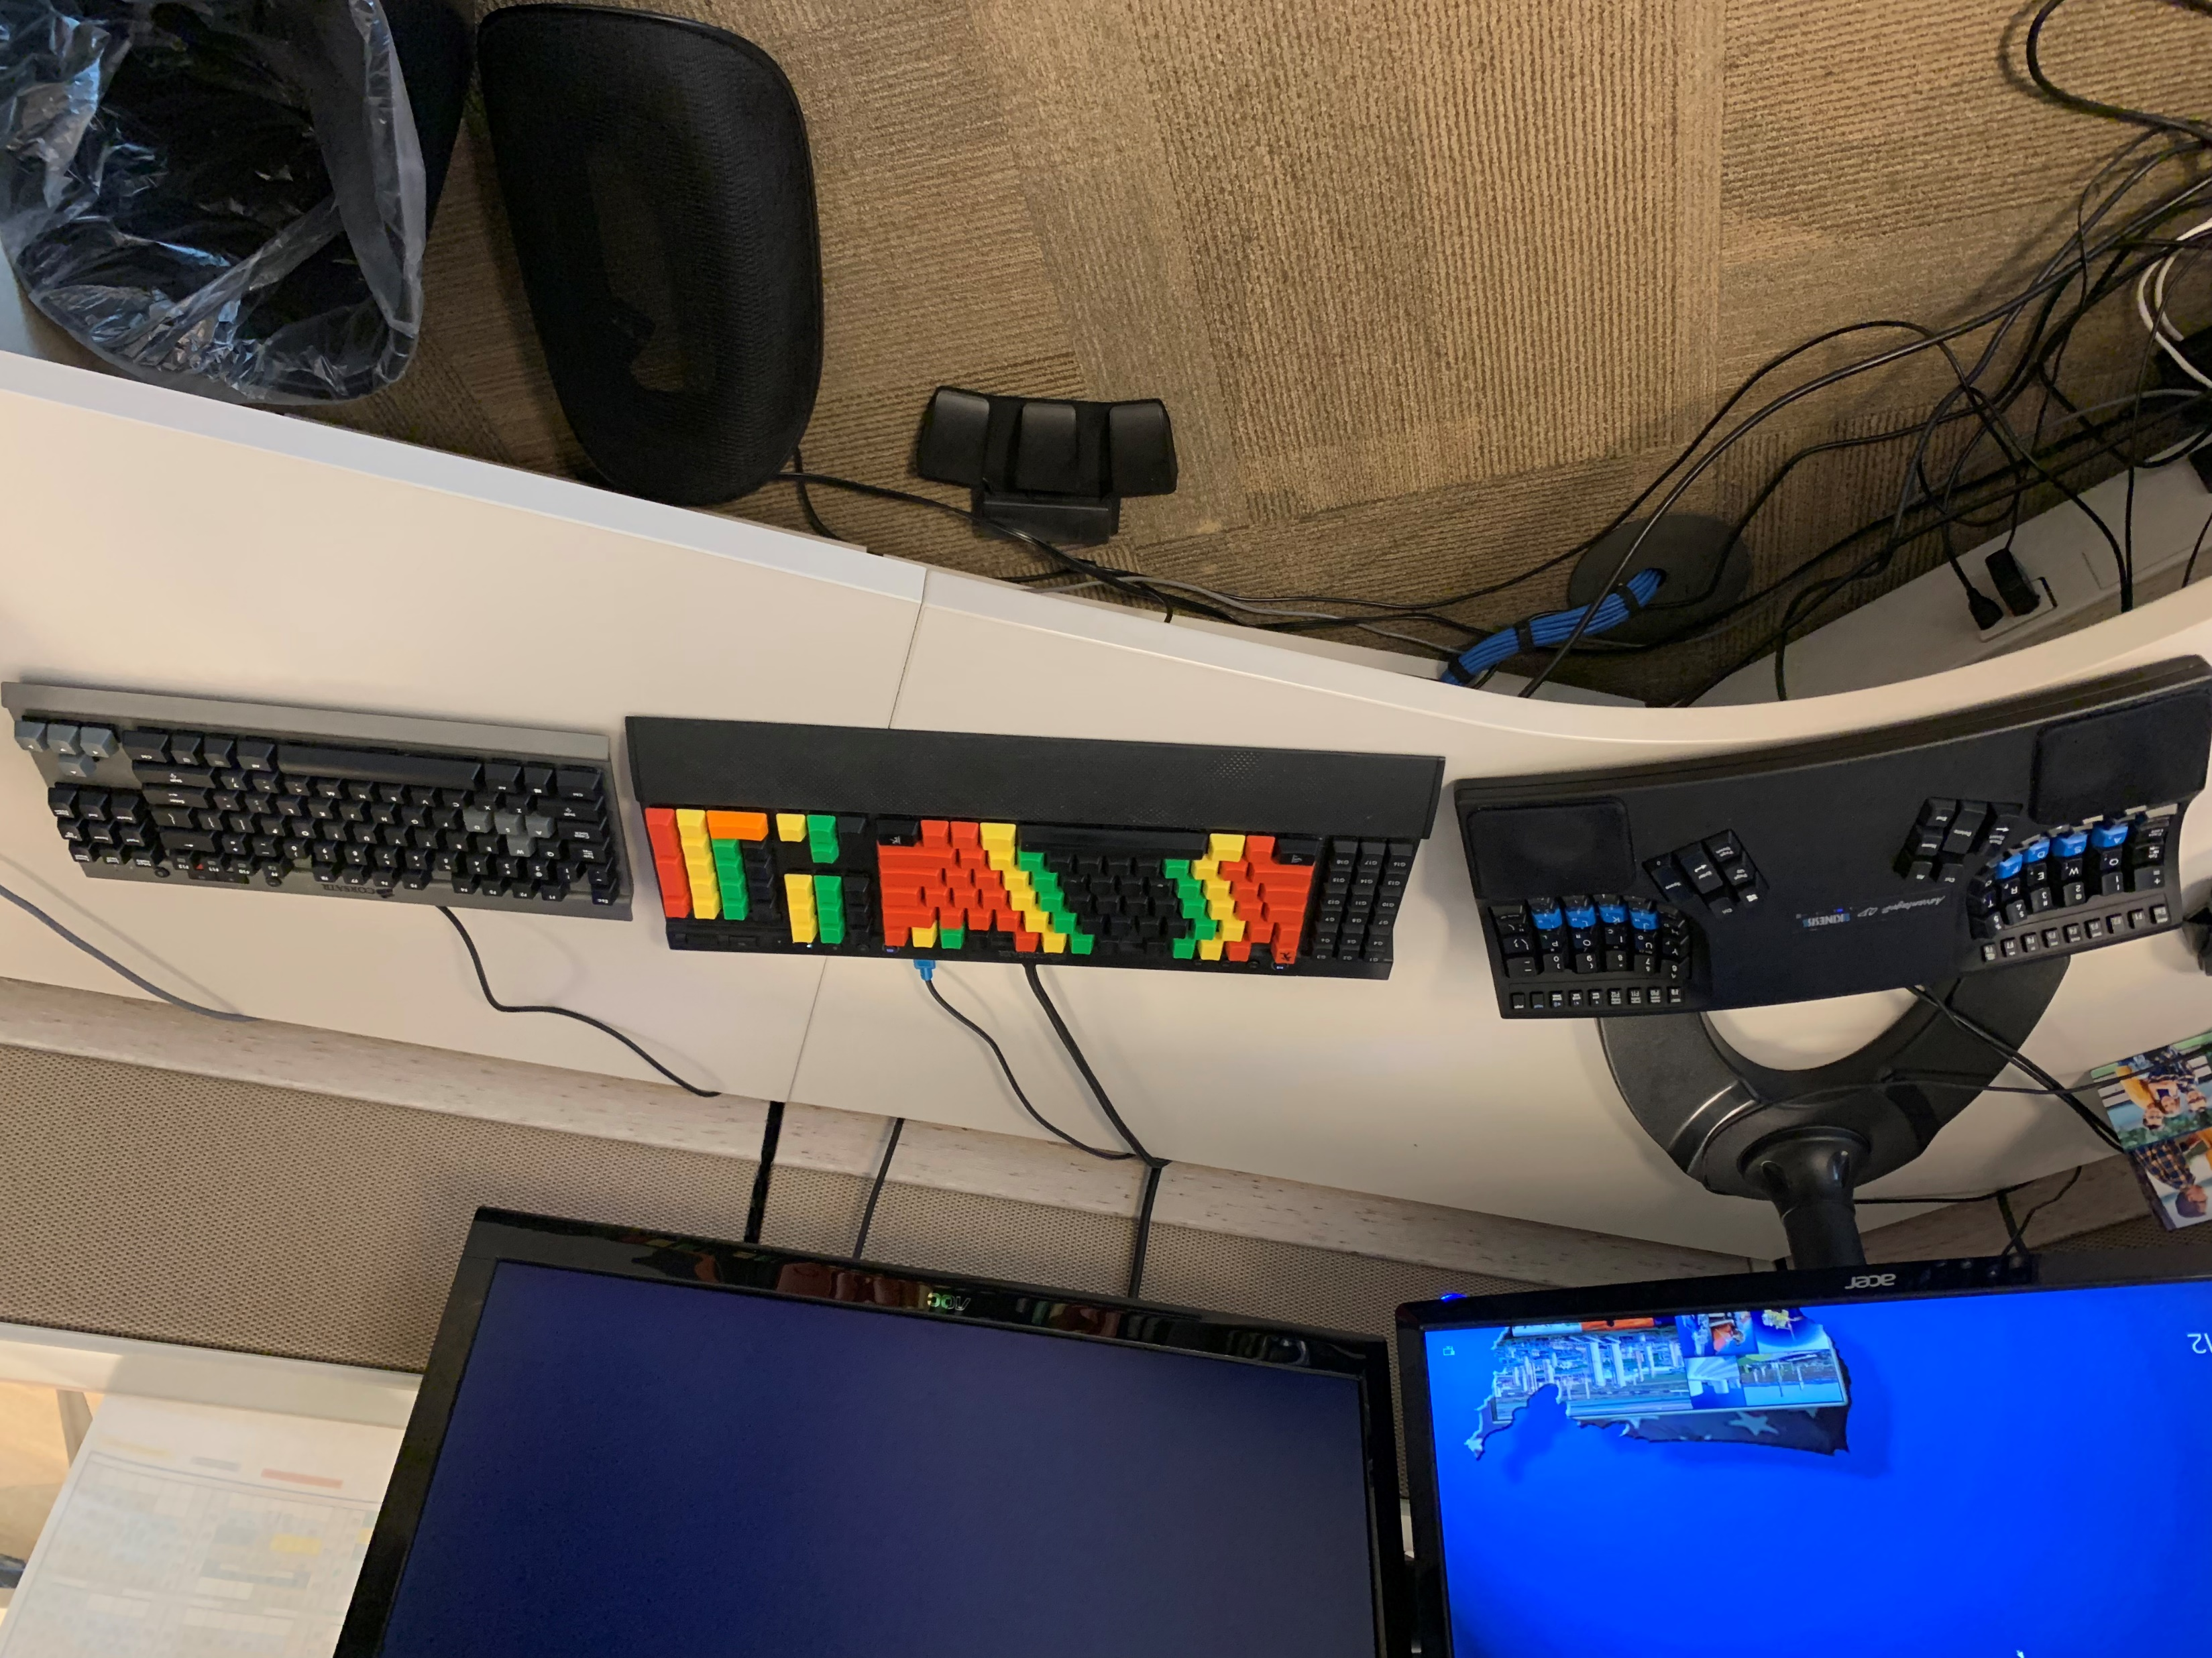
Obligatory Presenter Slides: Eric Burcham
OK, I lied. I have a keyboard for mortals, too.

Slide 7

Back in My Day…
We didn’t have Stack Overflow
We had to read books.

Slide 8
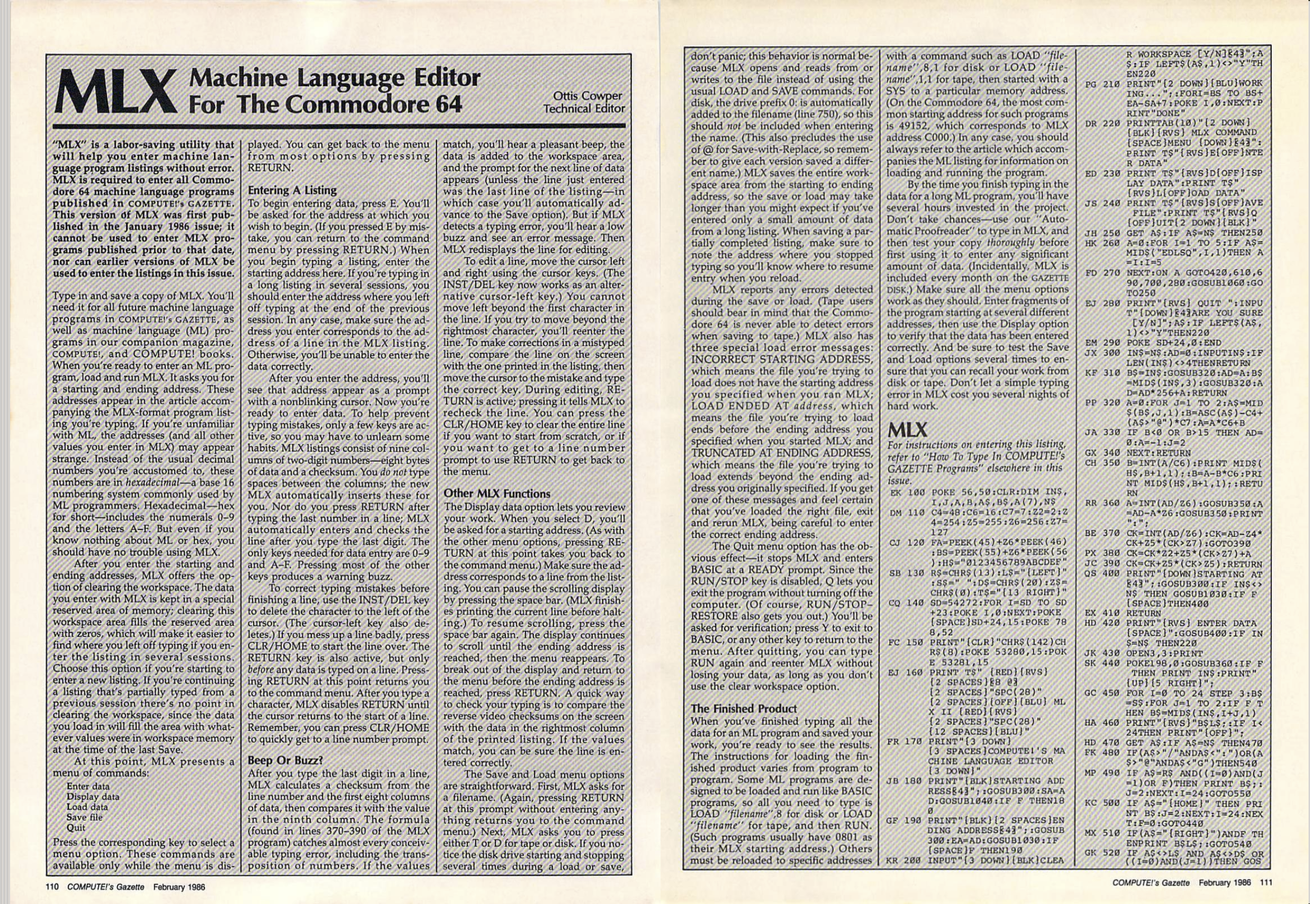
I Learned to Code From Compute’s Gazette

Slide 9
Presentation Overview
This is not a technical talk. There is zero code.
This is mostly an agile talk
It is also about how some crazy hard things get done

Slide 10
A Quick Plug
A word of thanks for Devlin Liles
A plug for Improving
I was an Improver
Why I left

Slide 11
Presentation Overview
Sabotage – Lessons from the CIA: How not to run your project.
Secrets – Lessons from DARPA: How to innovate consistently over time.
Spy planes – Lessons from the Lockheed Martin Skunk Works: Early examples of agile principles in practice.
We need to hustle, though…
We’ll check time after the first section.

Slide 12
One More Thing
Nothing original, here.
You can find all this information online and in published books.
Book references are at the end.
It’s my first time. Please be gentle.

Slide 13
First… The Agile Manifesto
Scrum, Kanban, and the like are processes. We’re talking principles today.
Individuals and interactions over processes and tools
Working software over comprehensive documentation
Customer collaboration over contract negotiation
Responding to change over following a plan
That is, while there is value in the items on the right, we value the items on the left more.

Slide 14
Why This Talk?
Not to knock the Agile Manifesto and its Authors, but…
Agile concepts and ideas are not new.
These three examples are just for fun.

Slide 15
Sabotage
How to literally ruin your project.

Slide 16
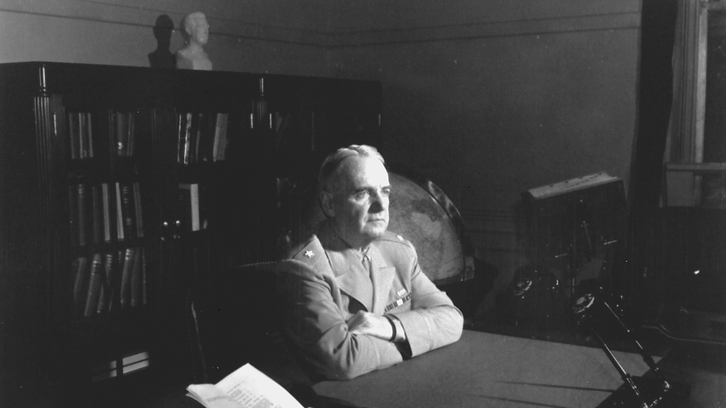
11 July, 1941: Office of the Coordinator of Intelligence
Notes:
1939: WWII Starts. Agencies collecting piecemeal intelligence.
FDR frustrated by piecemeal, stovepipe information reporting.
Creates OCI to streamline collection, organization, and dissemination of wartime intelligence.
Also created to conduct “unconventional” warfare.
Mostly moved under the Joint Chiefs of Staff to ensure military support.

Slide 17
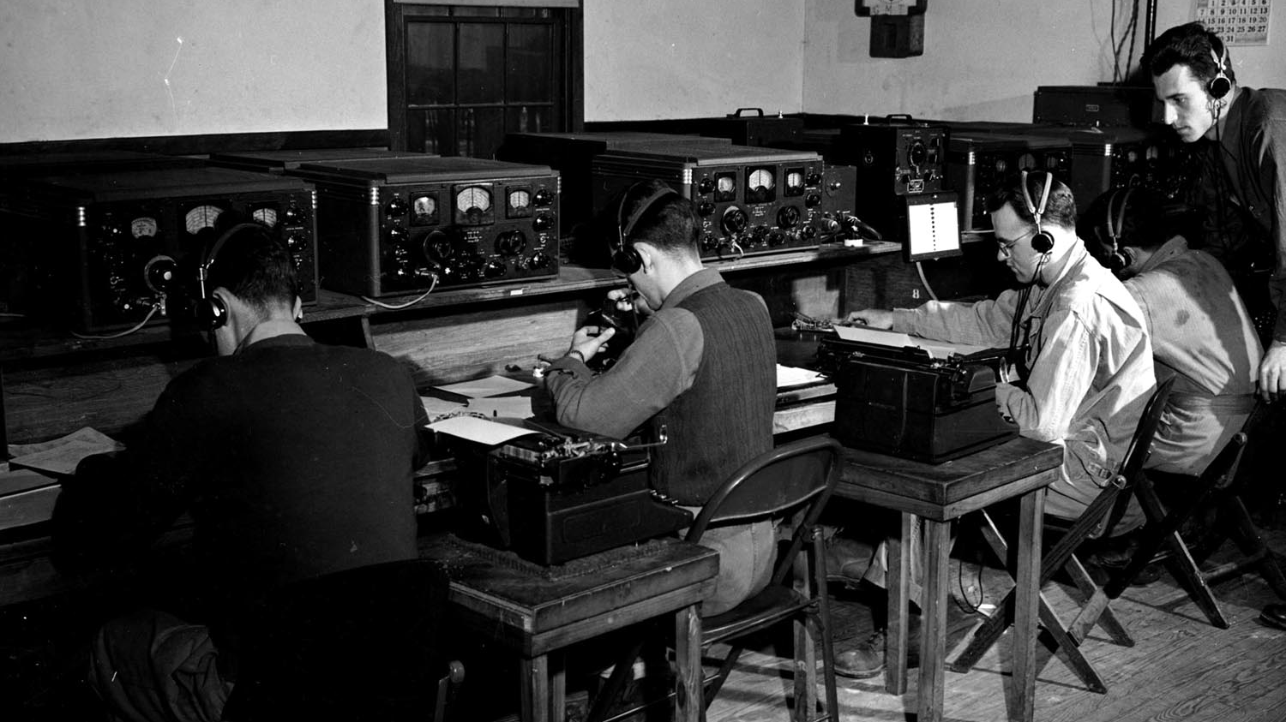
13 June, 1942: Office of Strategic Services
Notes:
Became a proactive, “strategic” organization.
Operated in North Africa, Europe, China, Burma, and India.
Never received complete jurisdiction over all foreign intelligence.
Most sensitive intelligence intercepts still went through military.
Eventually developed into counter-intelligence.
Grew to 13,000 people, 35% of whom were women.
No expectation of operating after the war.
Closed down with Truman’s election in 1945.
Counterintelligence and Secret Intelligence moved under the war department.

Slide 18
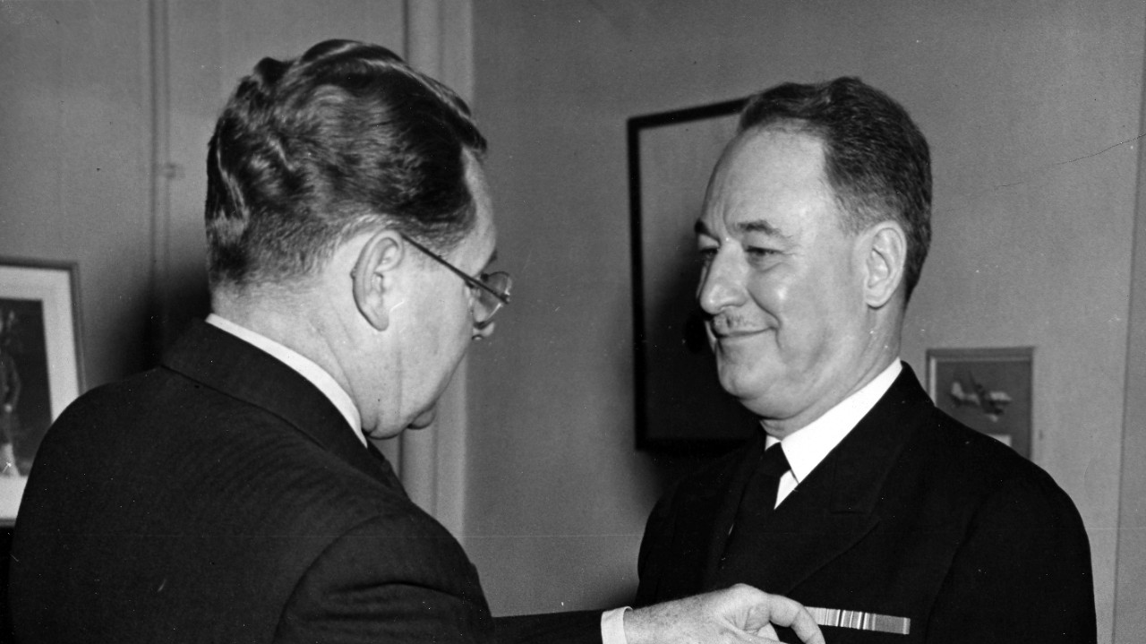
1 Oct, 1945: Strategic Services Unit
Notes:
Temporarily took over offices in London, Paris, Rome, Vienna, Cairo, Chungking, Calcutta, New Delhi, and Rangoon.
Really a stop-gap for a permanent solution as the nation’s leaders realized the necessity for peacetime foreign intelligence.
And, just as a “fun fact…”

Slide 19
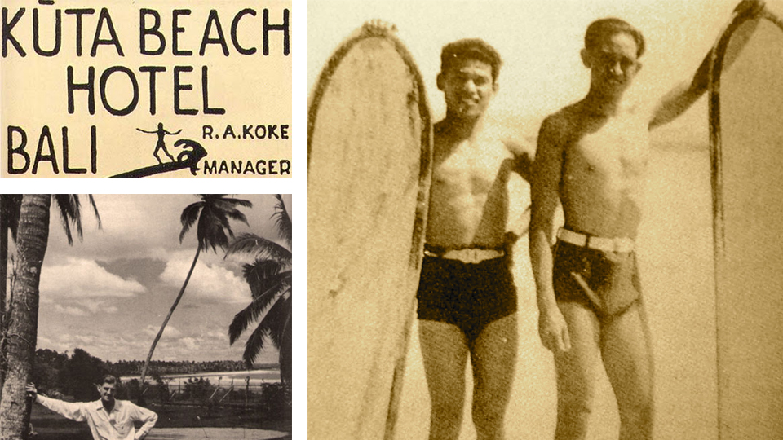
1 Oct, 1945: Strategic Services Unit
Notes:
One of its more important operatives, Robert A. Koke, was a civilian who introduced surfing to Indonesia. He also opened Indonesia’s first major surfing destination, the Kuta Beach Hotel, in Bali.

Slide 20
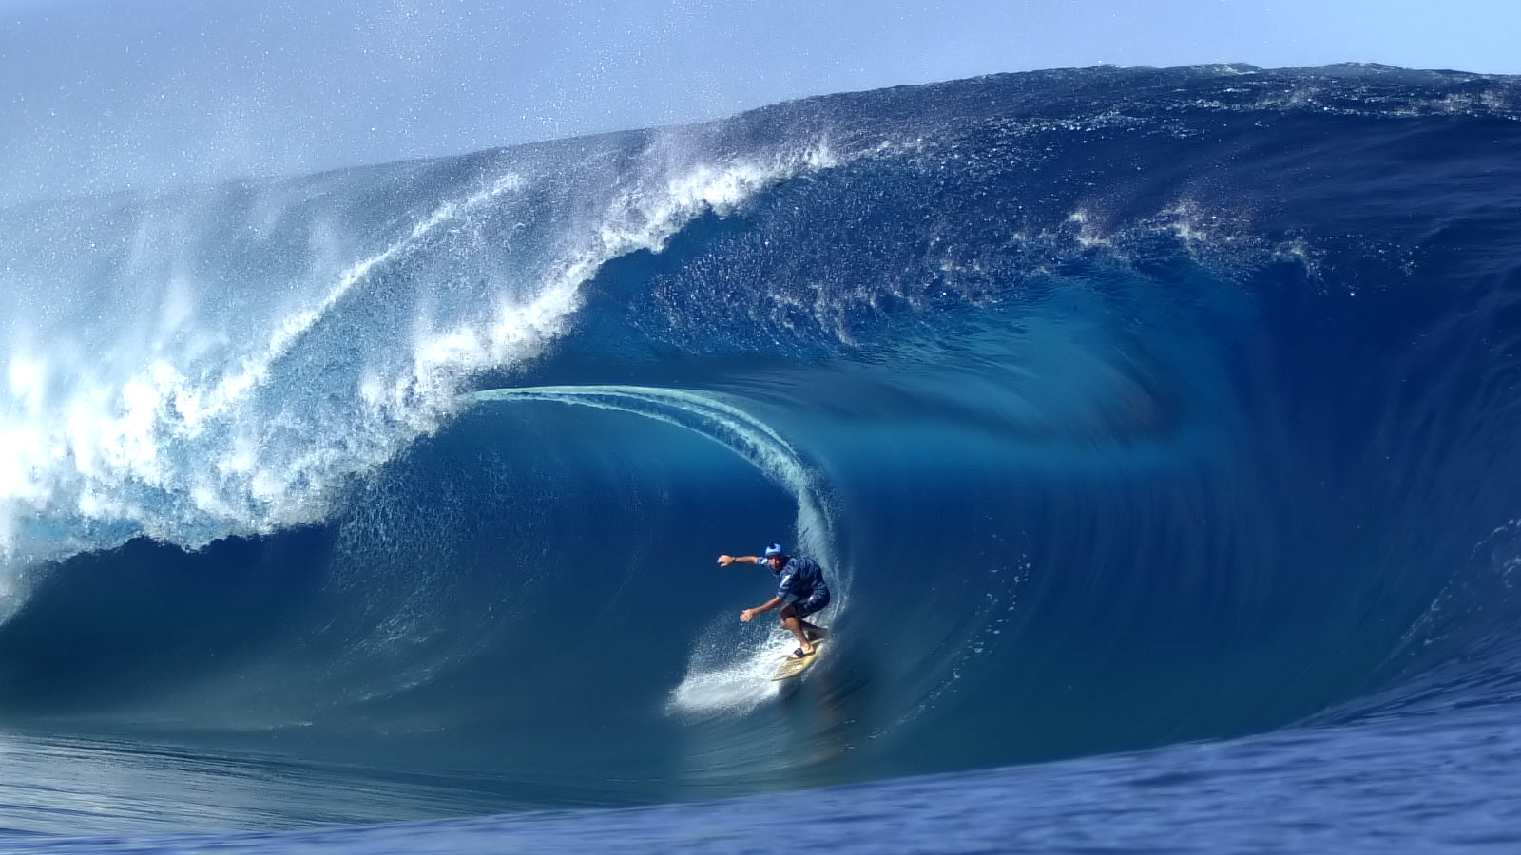
Oct 1945 – The End of Time: Surfing at Kuta Beach
Notes:
This modern surfing Mecca is, in the Author’s almost certainly incorrect opinion, the most important legacy of the SSU.

Slide 21
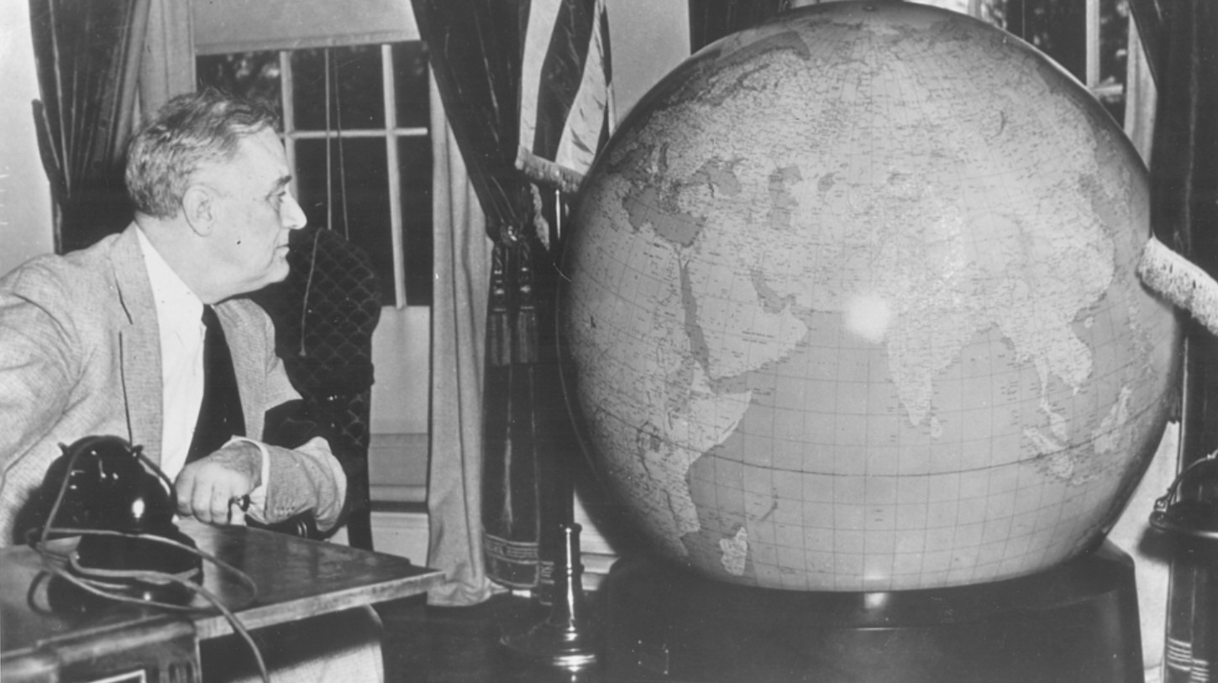
Jan 1946: Central Intelligence Group
Notes:
This was a new national intelligence authority, and the SSU was moved under its umbrella.
This decision was made solely on the challenge of producing coordinated intelligence reports from multiple agencies; a problem we still face today.
Another “fun fact” is that during all this time, some of the most amazing cartography work the world has ever seen was being done by the predecessors of the CIA. This culminated under the CIG.
The CIG stopped just coordinating intelligence and began producing it own its own.
Became the nation’s leading agency for strategic warning and managing clandestine operations overseas.
It was still shackled by the military, and was recreated under its own department as the CIA we know today.

Slide 22
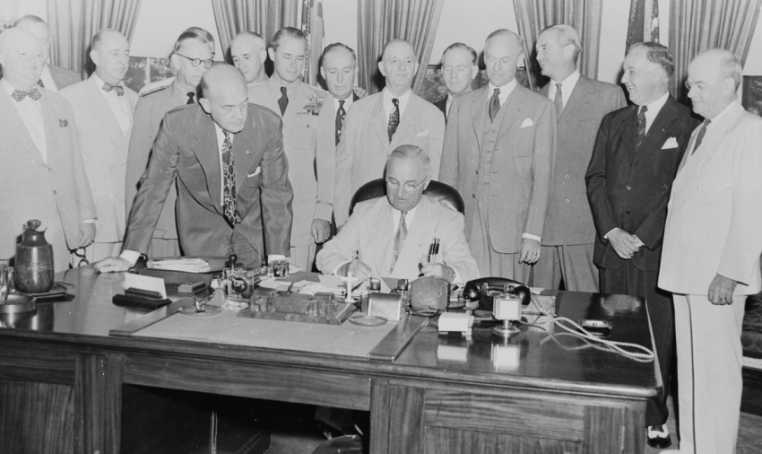
18 Sept, 1947: Central Intelligence Agency
Notes:
Created by President Truman, the same president who shut down the OSS, in September 1947. 1/3 of employees are OSS veterans.
Added a great deal of breadth to the existing mission of the CIG.
Got a big set of buildings that made it seem to stand on its own, aside from military apparatus.

Slide 23
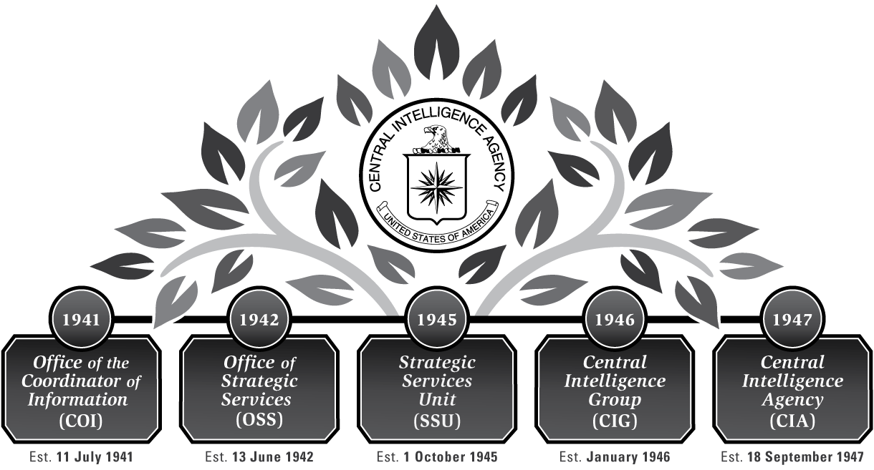
Why Talk about the CIA?

Slide 24
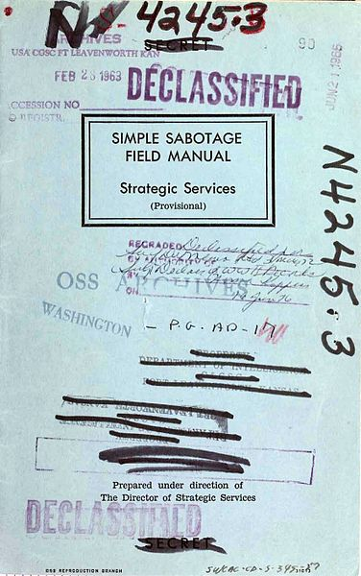
1942: Simple Sabotage Field Manual (OSS)

Slide 25
What We Won’t Cover
Destroying buildings
Potty Humor
Lighting things on fire
Damaging industrial equipment
Messing with vehicles
Wrecking electrical systems
Burning up electric motors
Anything else where people might actually get hurt

Slide 26
Interfering with Organizations and Production
Insist on doing everything through channels. Never permit shortcuts to be taken in order to expedite decisions.
When possible, refer all matters to committees, for “further study and consideration.” Attempt to make committees as large as possible.
Haggle over precise wording of communications, minutes, and resolutions.
Refer back to matters decided upon at the last meeting and attempt to re-open the question of the advisability of that decision.

Slide 27
Interfering with Organizations and Production
Be worried about the propriety of any decision — raise the question of whether such action as is contemplated lies within the jurisdiction of the group or whether it might conflict with the policy of some higher echelon.
In making work assignments, always sign out the unimportant jobs first. See that the important jobs are assigned to inefficient workers of poor machines.
Insist on perfect work in relatively unimportant products; send back for refinishing those which have the least flaw. Approve other defective parts whose flaws are not visible to the naked eye.

Slide 28
Interfering with Organizations and Production
When training new workers, give incomplete or misleading instructions.
Hold conferences when there is more critical work to be done.
Multiply paper work in plausible ways. Start duplicate files.
Multiply the procedures and clearances involved in issuing instructions, pay checks, and so on. See that three people have to approve everything where one would do.
Apply all regulations to the last letter.

Slide 29
Interfering with Organizations and Production
Spread disturbing rumors that sound like inside dope.
Contrive as many interruptions to your work as you can.
When you misunderstand things not in your native tongue, do not bother to clarify them.
Pretend that instructions are hard to understand, and ask to have them repeated more than once. Or pretend that you are particularly anxious to do your work and pester the foreman with unnecessary questions
Never pass on your skill and experience to a new or less skillful worker.

Slide 30
Interfering with Organizations and Production
Snarl up administration in every possible way. Fill out forms illegibly so that they will have to be done over; make mistakes or omit requested information in forms.
If possible, join or help organize a group for presenting employee problems to the management. See that the procedures adopted are as inconvenient as possible for the management, involving the presence of a large number of employees at each presentation, entailing more than one meeting for each grievance, bringing up problems which are largely imaginary, and so on.

Slide 31
Interfering with Organizations and Production
Be as irritable and quarrelsome as possible without getting yourself into trouble.
Complain against ersatz materials.
Stop all conversation when axis nationals or quislings enter a cafe.
Cry and sob hysterically at every occasion, especially when confronted by government clerks.
Do not cooperate in salvage schemes.

Slide 32
Basic Tradecraft for Intelligence Analysis
We don’t have time, but
Go read this:
A Tradecraft Primer: Structured Analytic Techniques for Improving Intelligence Analysis

Slide 33
Secrets
How to innovate often and forever.

Slide 34
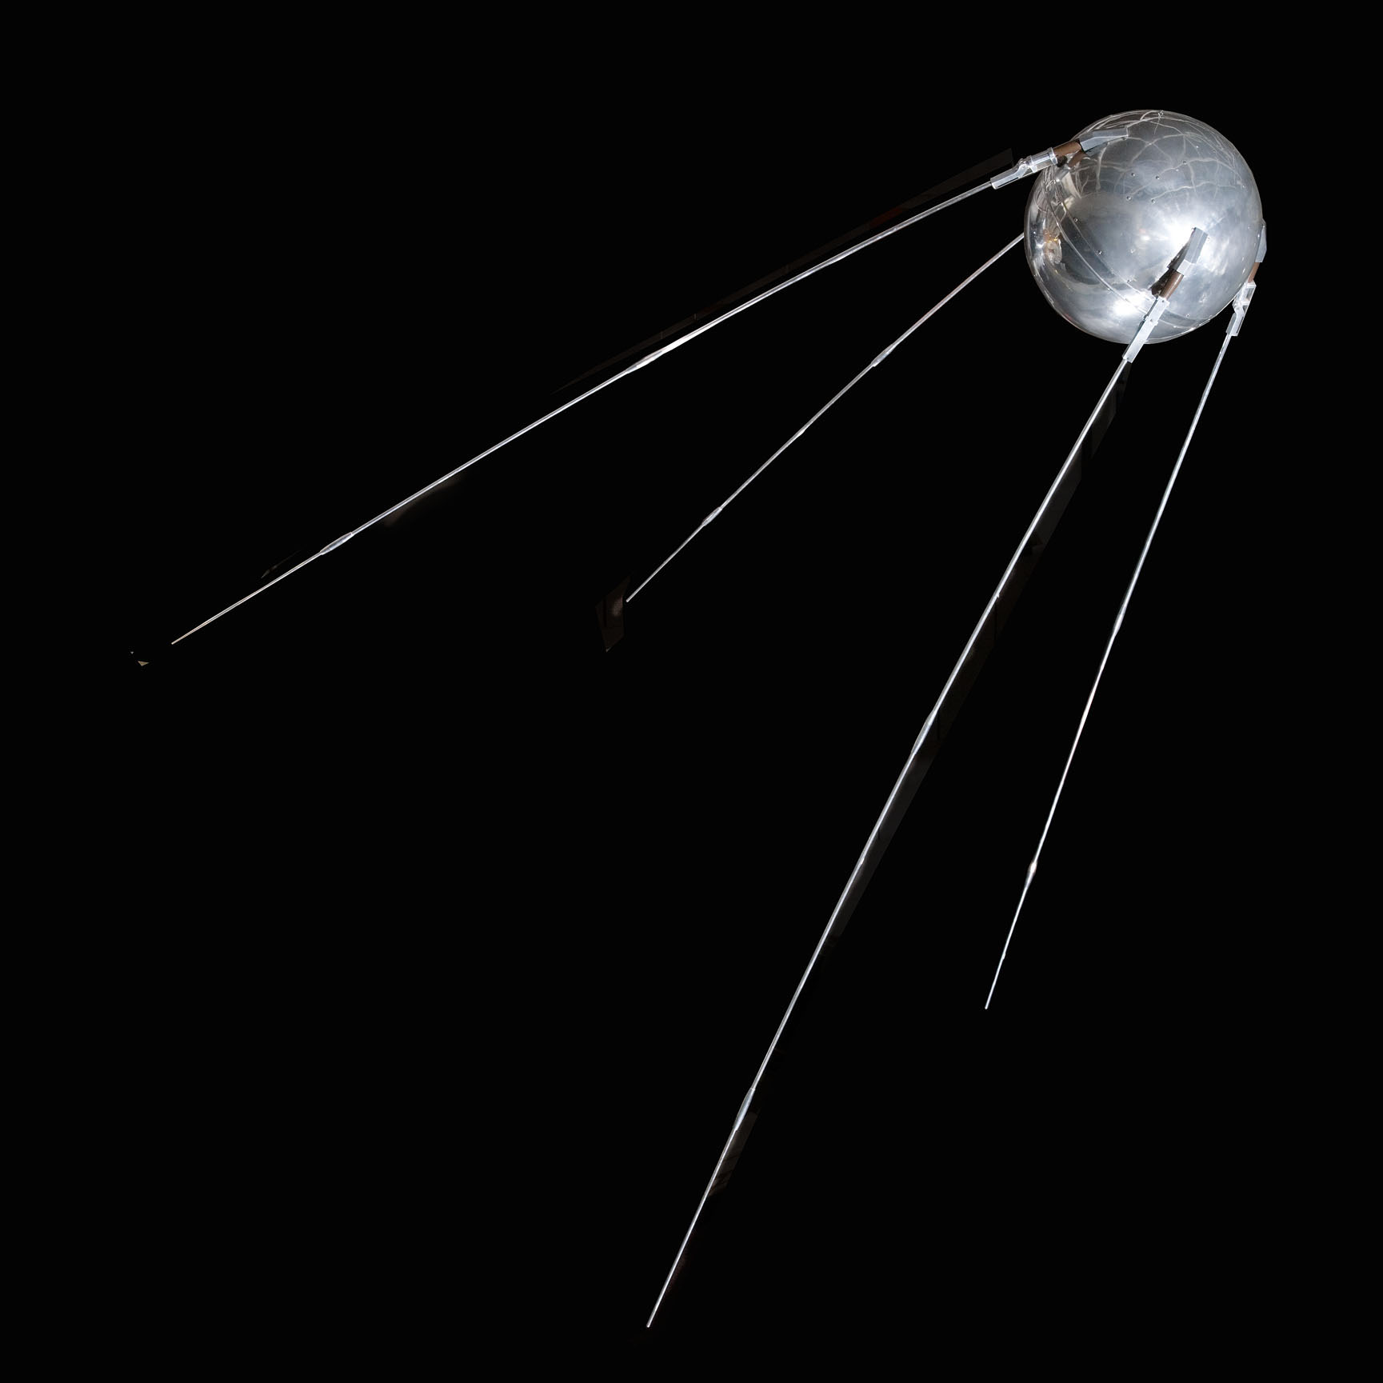
Sputnik
First man-made satellite.
No, DARPA didn’t make it. DARPA grew out of it.

Slide 35
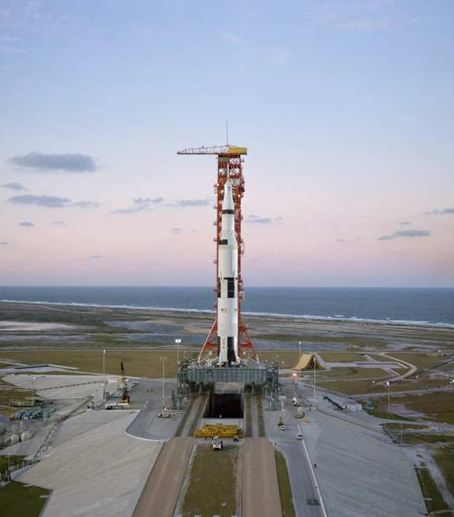
Saturn V & Centaur
Managed and funded the origins of these programs
Transferred to NASA

Slide 36
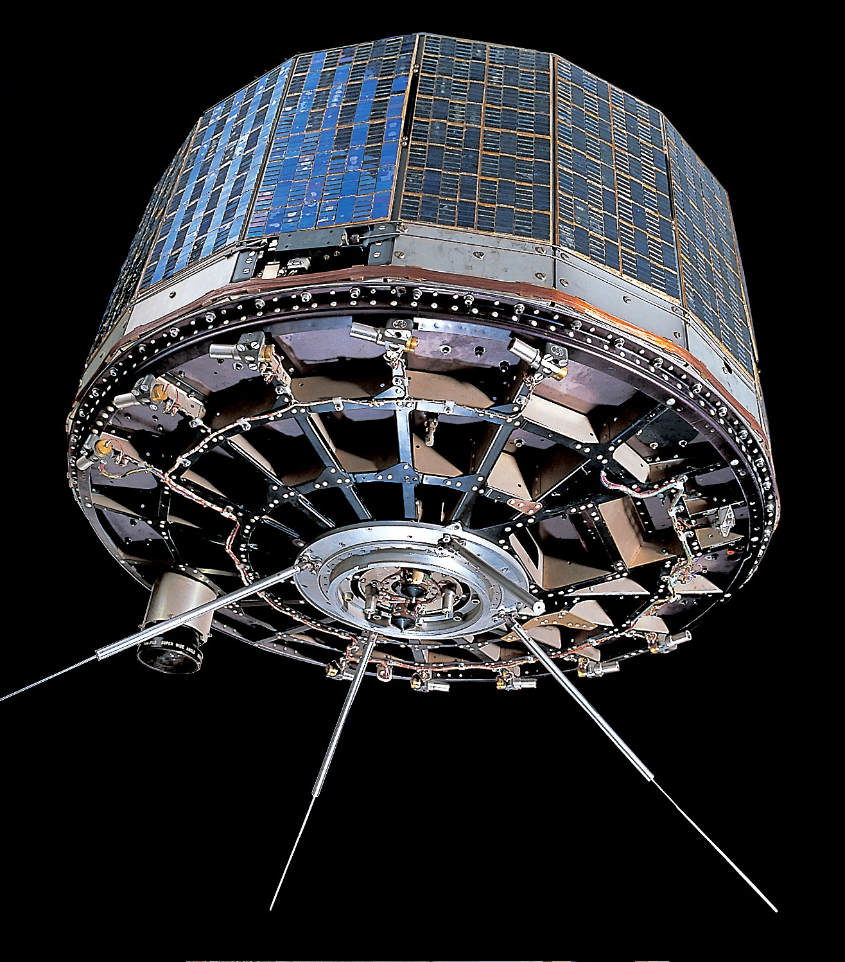
Tiros

Slide 37
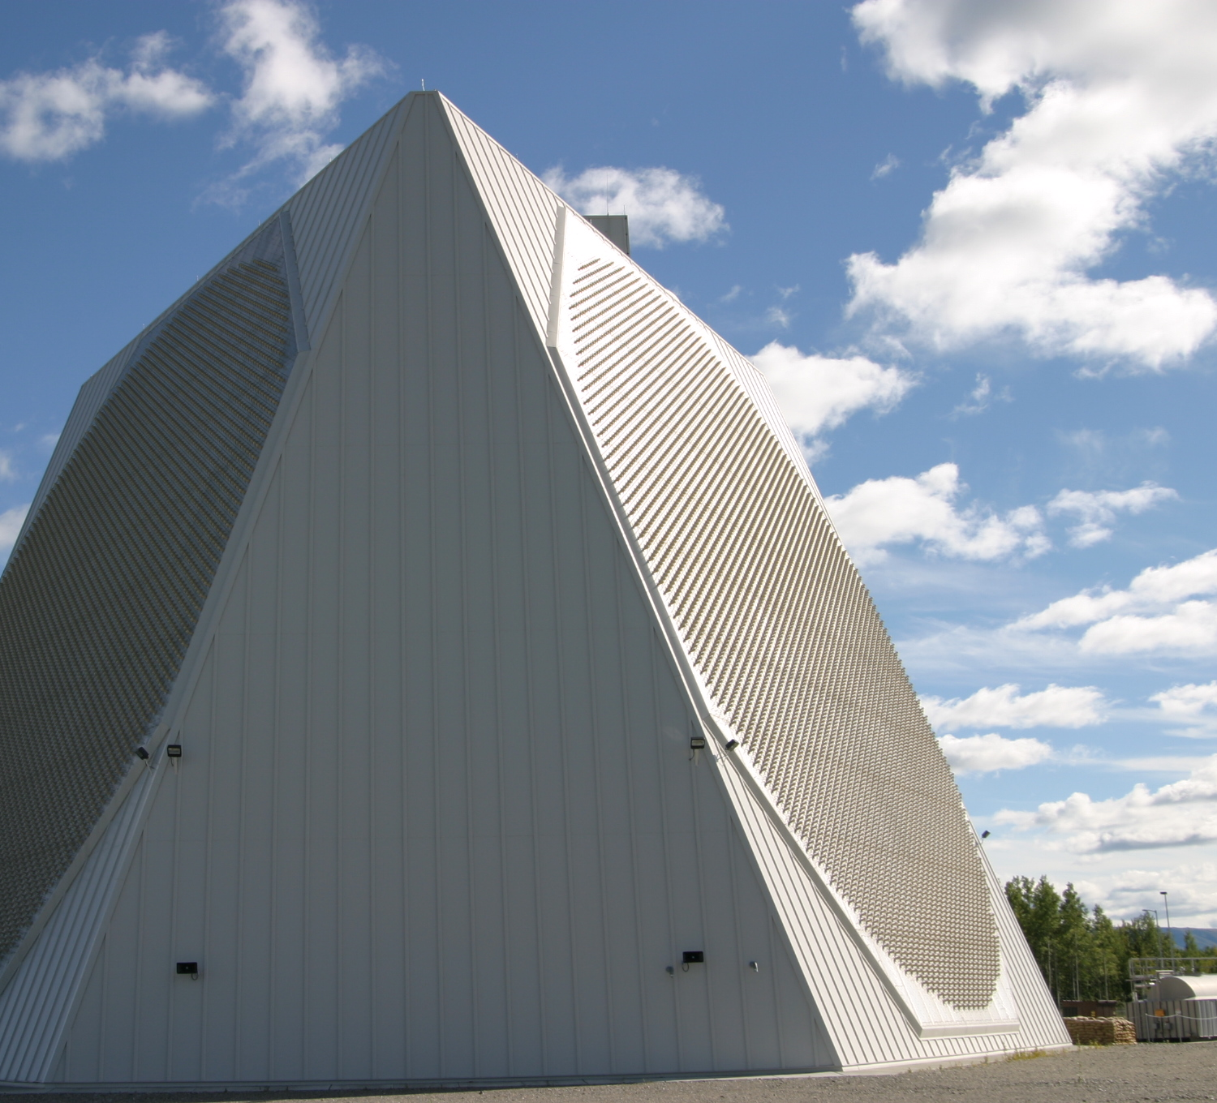
Phased Array Rader
For stopping nukes
‘Nuff said

Slide 38
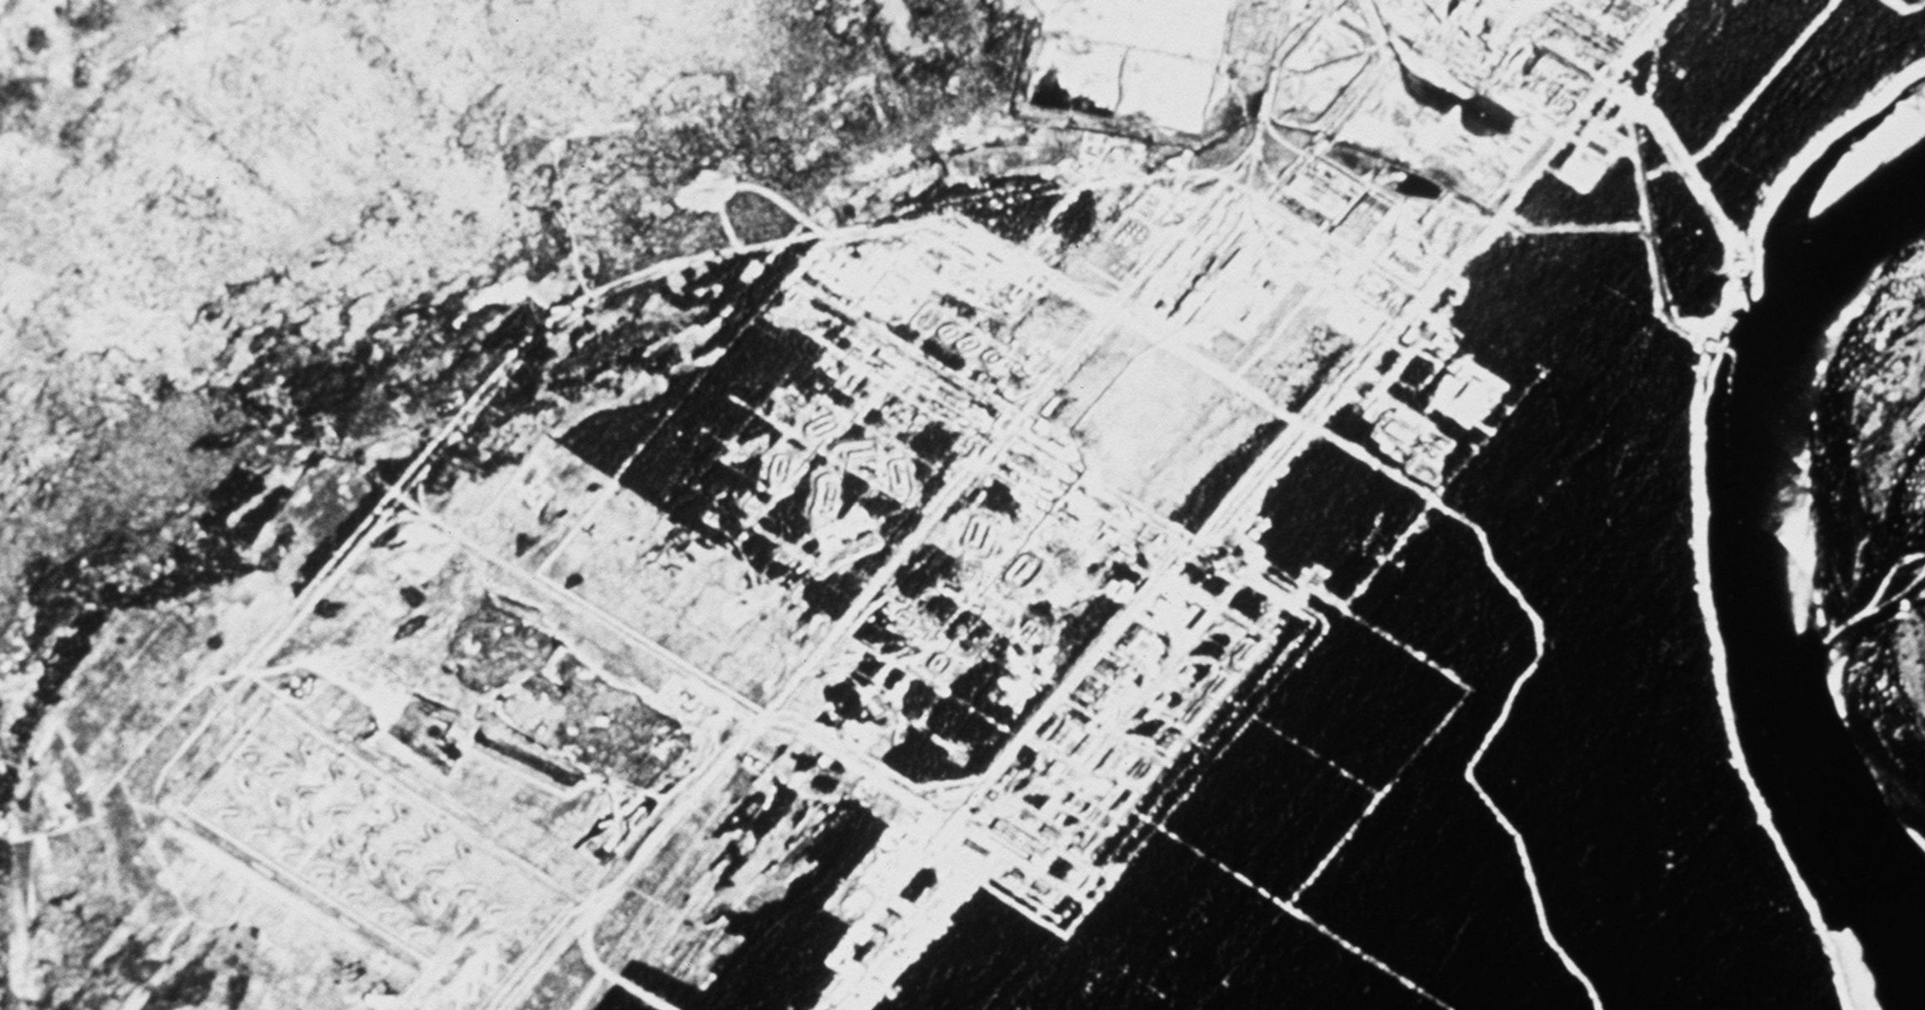
Corona Reconnaissance Satellites

Slide 39
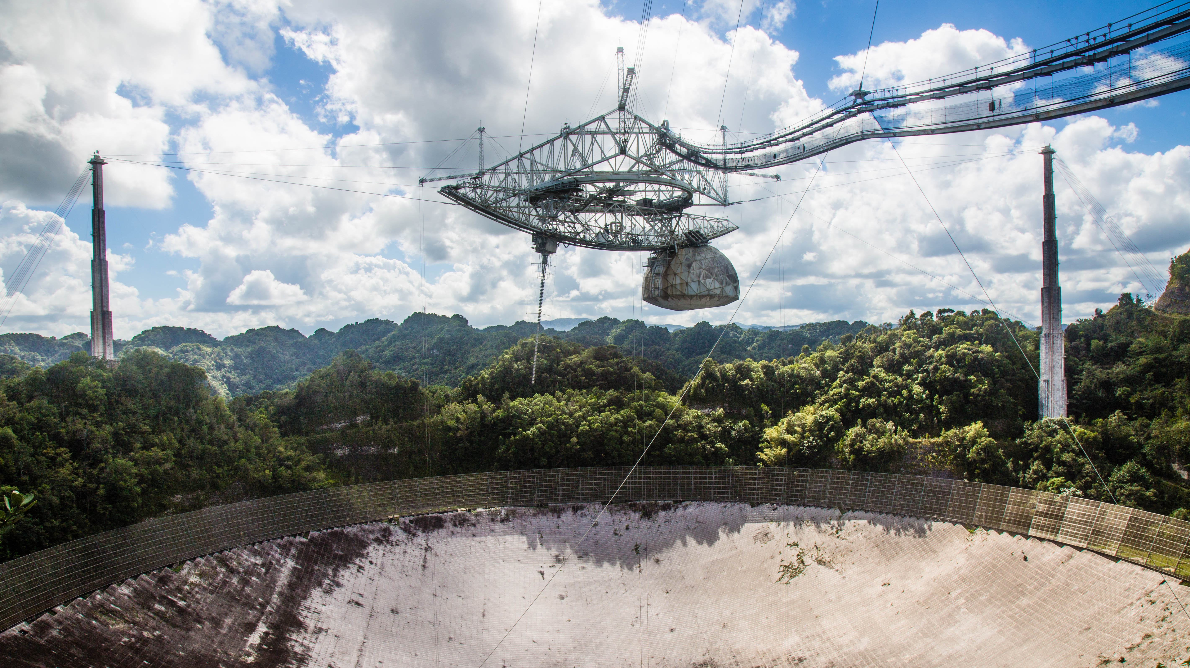
Arecibo Observatory

Slide 40
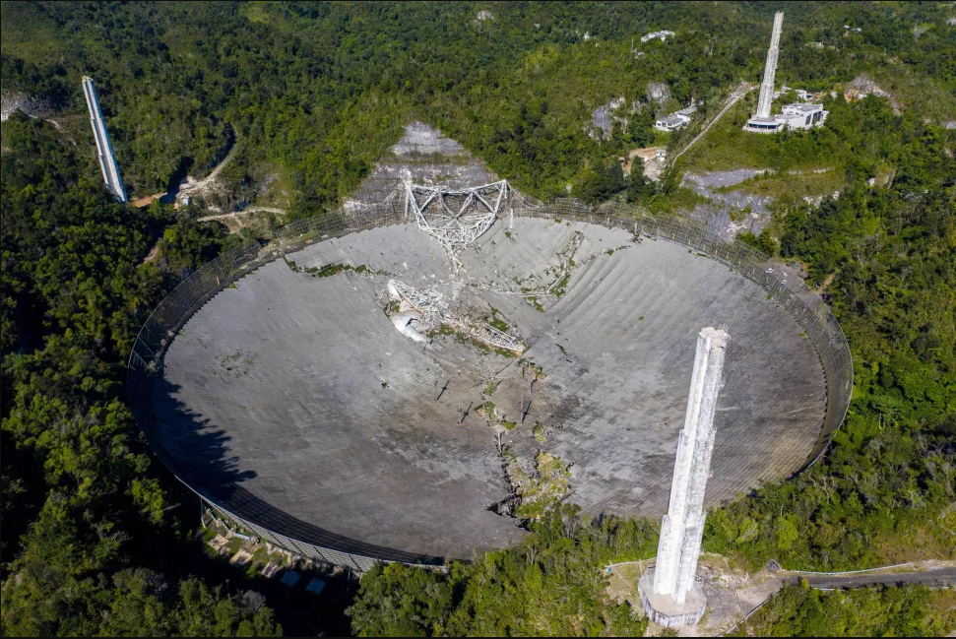
Arecibo Observatory
RIP

Slide 41
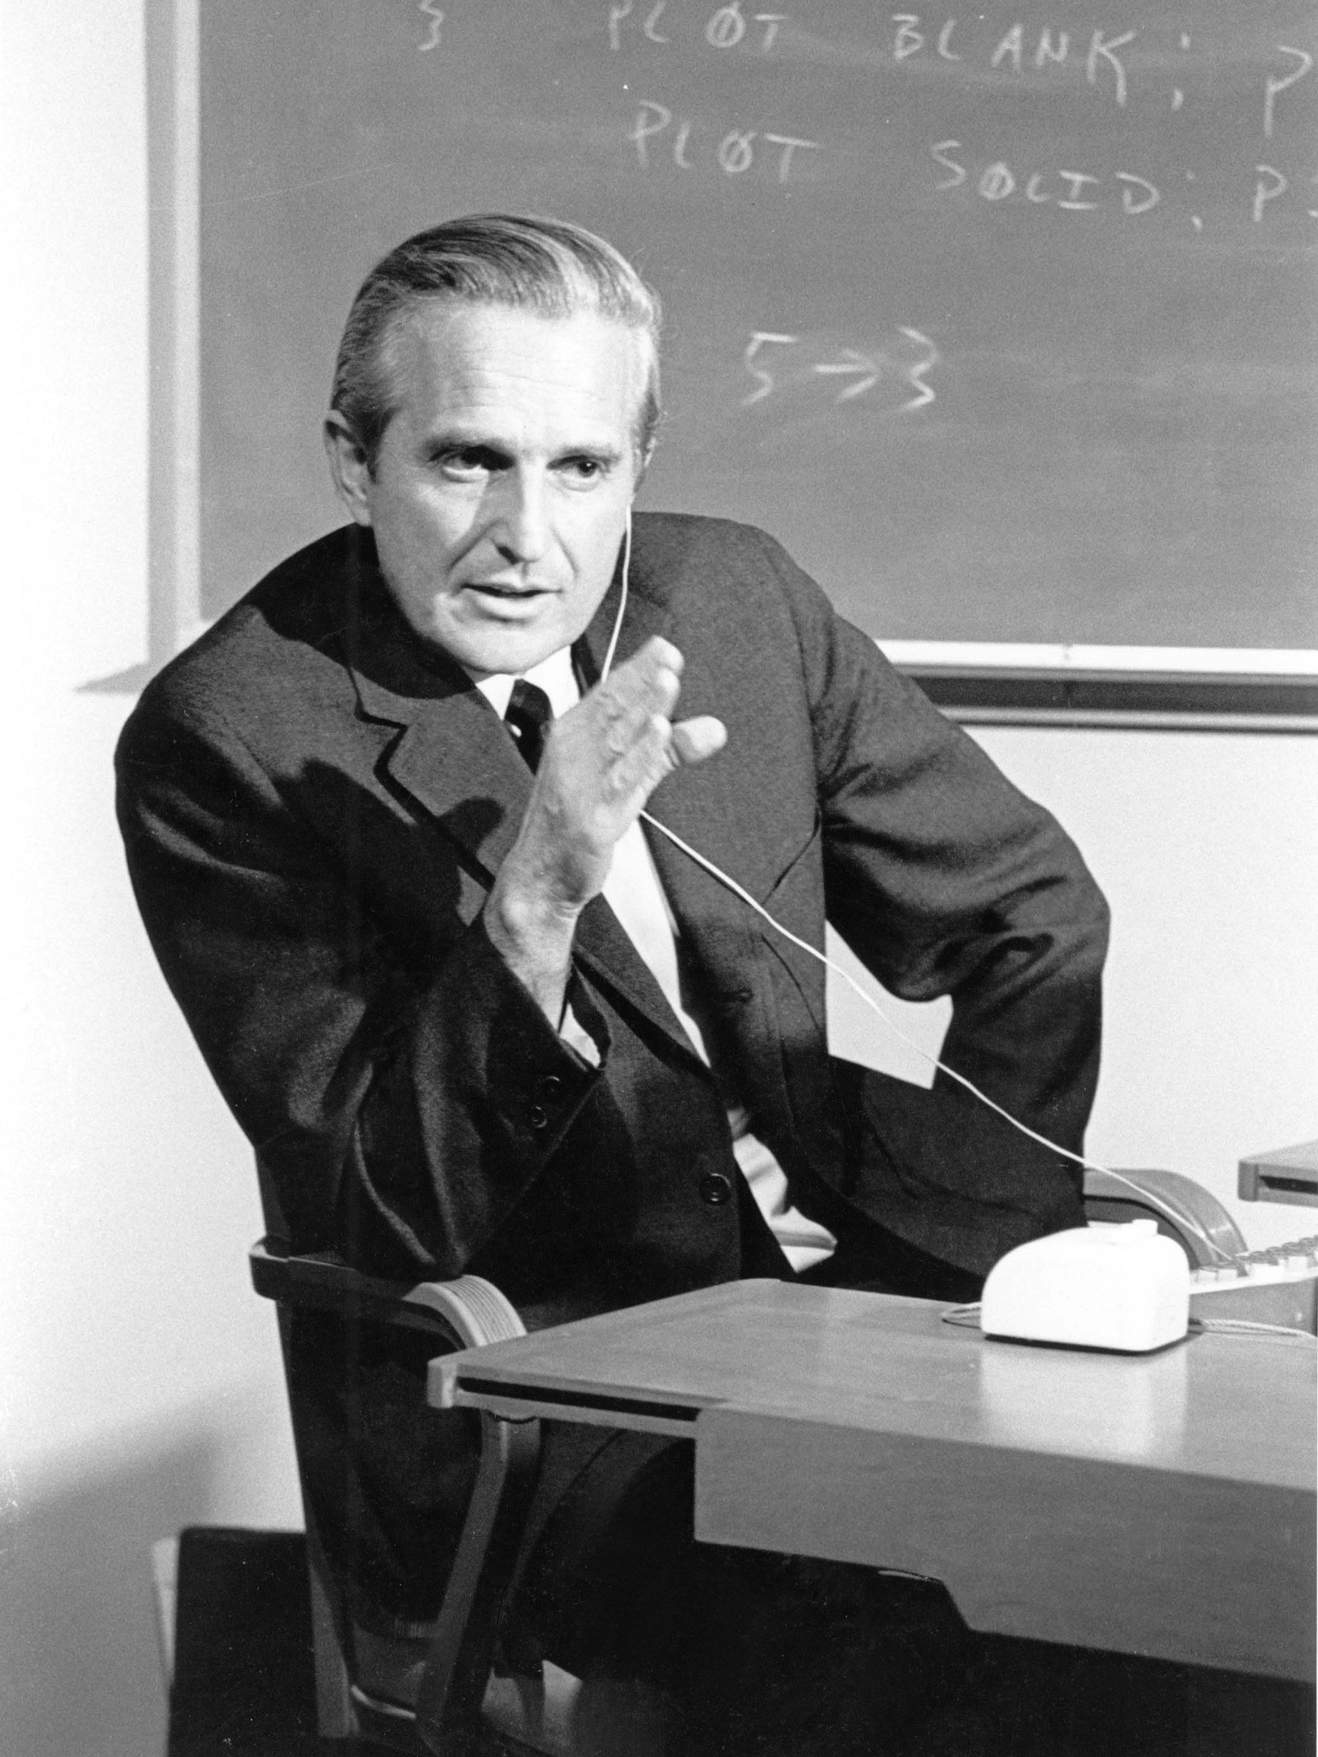
Mother of All Demos (1968)
Mouse Control and Feedback
Video Conferencing
Teleconferencing
Hypertext
Word Processing
Hypermedia
Object Addressing
Dynamic File Linking
Bootstrapping
Collaborative Realtime Editor

Slide 42
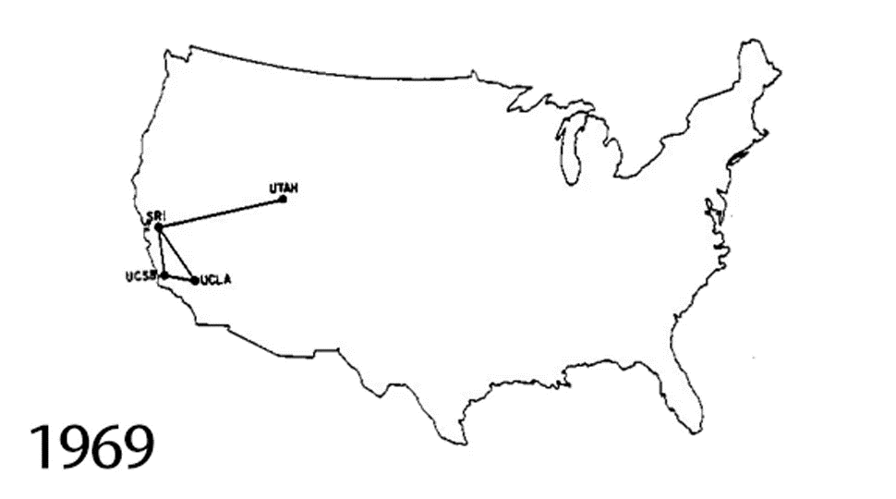
ARPA Network

Slide 43
You Get The Idea…
Compact Turbofans
Torpedo Propulsion
Beryllium Mirrors (Missile Guidance)
Gallium Arsenide (Needed for GPS)
TCP/IP
HAVE BLUE and other stealth tech
Sea Shadow (modern stealth warships)
UAVs

Slide 44
You Get The Idea…
High Definition Systems (in the 1980’s)
Active Tank Armor
Spintronics (astoundingly dense data storage)
PAL (Precursor to Siri)
Chip-Scale Atomic Clocks (really. I’m not kidding)
Amazing Prosthetics
Automated High-altitude refueling
Massive Data Analysis (in 2008)

Slide 45
And the List Goes On
RISC processors
Micro electromechanical systems (needed for inkjet printers)
High-altitude LIDAR (unprecedented geospatial data)
Radar for UAVs (It’s really small for radar)
Blast Gauge (alerts medics if warfighters are exposed to explosives)
Truly countless others…

Slide 46
The point, really…
DARPA has continually innovated global change for 60+ years.
Unparalleled number of breakthroughs
Most consistent track record of radical invention in history *
We want to know how they do it…

Slide 47
How DARPA gets it done.
Support staff is tiny: 120 people total in:
Finance
Contracting
HR
Security
Legal
The comparative budget is tiny. 200+ programs for about $3.5B.
Projects last only 3-5 years.

Slide 48
How DARPA gets it done.
About 100 temporary program managers.
Engaged community. Vibrant mix of workers from:
Universities
Companies of all sizes
Laboratories
Government partners
Nonprofits

Slide 49
DARPA Model: Independence
Autonomous (by charter) in selecting projects.
Bypasses, to a great extent, typical approvals process.
Encourages broad participation through
Proposals
Prizes
Pursues transformational change, rather than incremental advancement.
Doesn’t focus on plumbing.

Slide 50
DARPA Model: Ambitious Goals
Harness science and engineering:
Solve real-world problems, or
Create new opportunities
Problems must be challenging enough to push or catalyze the science.
Urgent need for application creates focus and inspires genius.

Slide 51
DARPA Model: Temporary Project Teams
World-class experts work on projects of short duration.
Academia
Industry
Organized and led by fixed-term technical managers
Themselves experts in their fields, and
Exceptional leaders
Specially not open-ended research programs

Slide 52
DARPA Model: Temporary Project Teams
Highest-caliber talent attracted by:
Intensity
Sharp focus
Finite time frame
Nature of challenge inspires unusual levels of collaboration.
Tries to get great people to tackle great challenges with other great people.

Slide 53
DARPA: Committed to Pasteur’s Quadrant
 |  | Solves Immediate Problems?
 |  | No | Yes
Increases Fundamental Knowledge? | Yes | Purse Basic Research | Use-inspired basic research
 | No | Not research | Pure applied research

Slide 54
What does DARPA have to do with Agile?
Focused on individuals and interactions.
Focused on a working, practical, result.
Focused on collaboration.
Focused on face-to-face conversations.
Build projects around well-supported, motivated individuals.
Working result is the primary measure of progress.
Maximizes the work not done.
Self-organizing teams.
Track effectiveness at regular intervals.

Slide 55
Spy planes
Principles for being on time and under budget.

Slide 56
A Little About the Skunk Works
Created During the Stress of WWII
Develop a reputation for being “on time and under budget”
Maintained that reputation for a long time
Not so much these days…

Slide 57
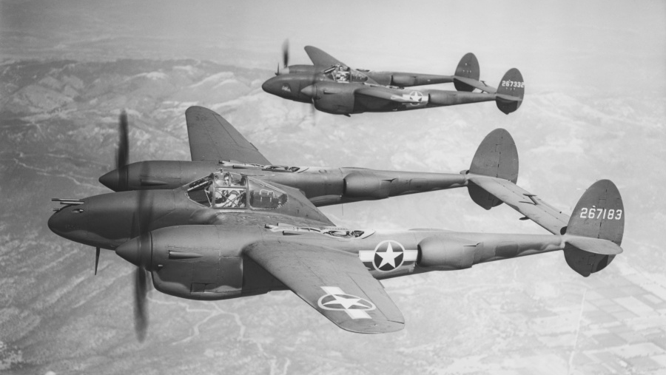
P-38 Lightning

Slide 58
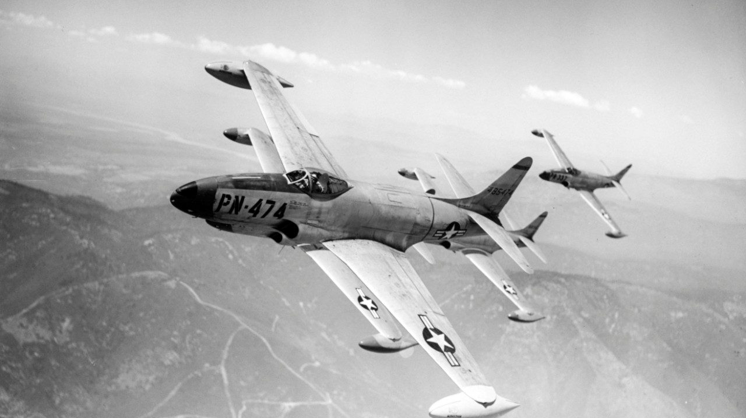
P-80 Shooting Star

Slide 59
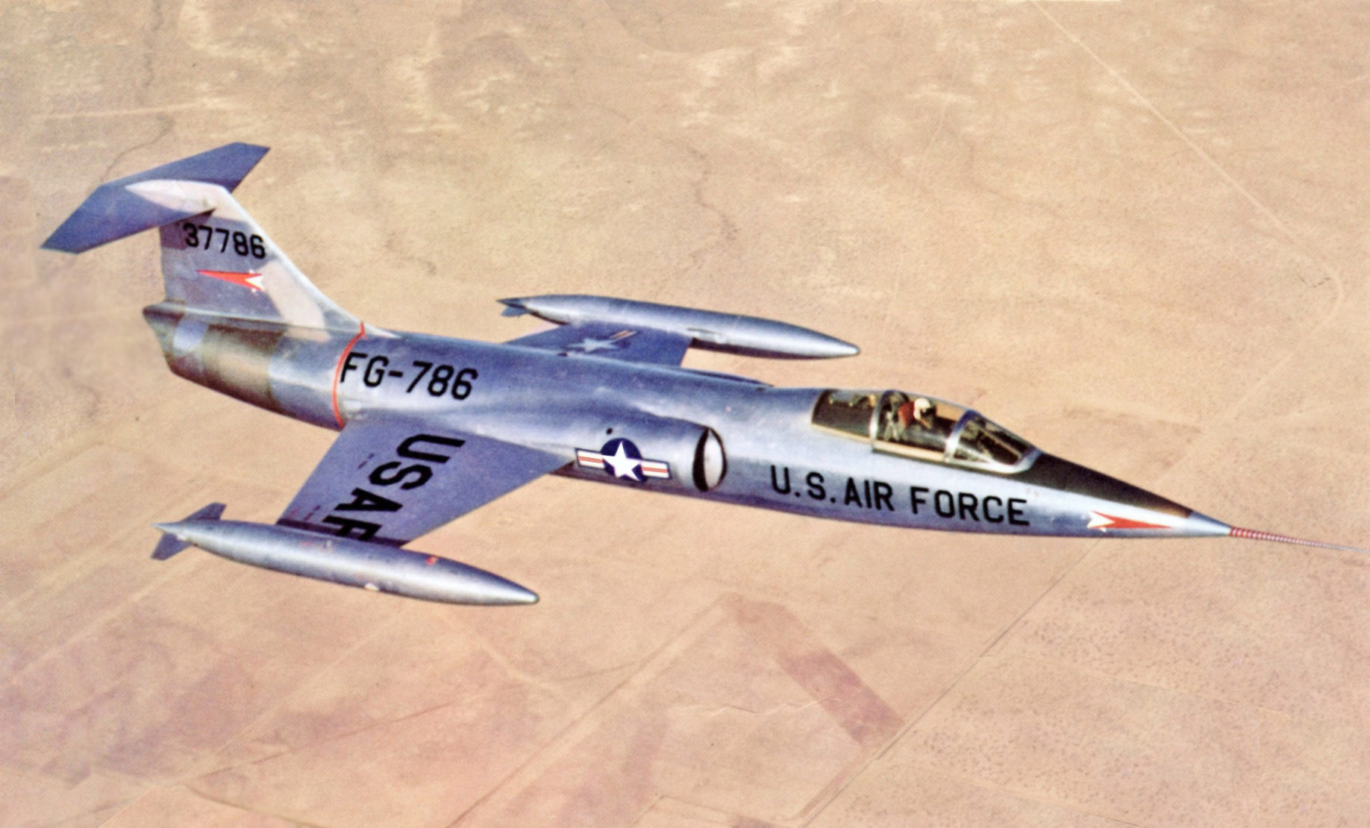
F-104 Starfighter

Slide 60
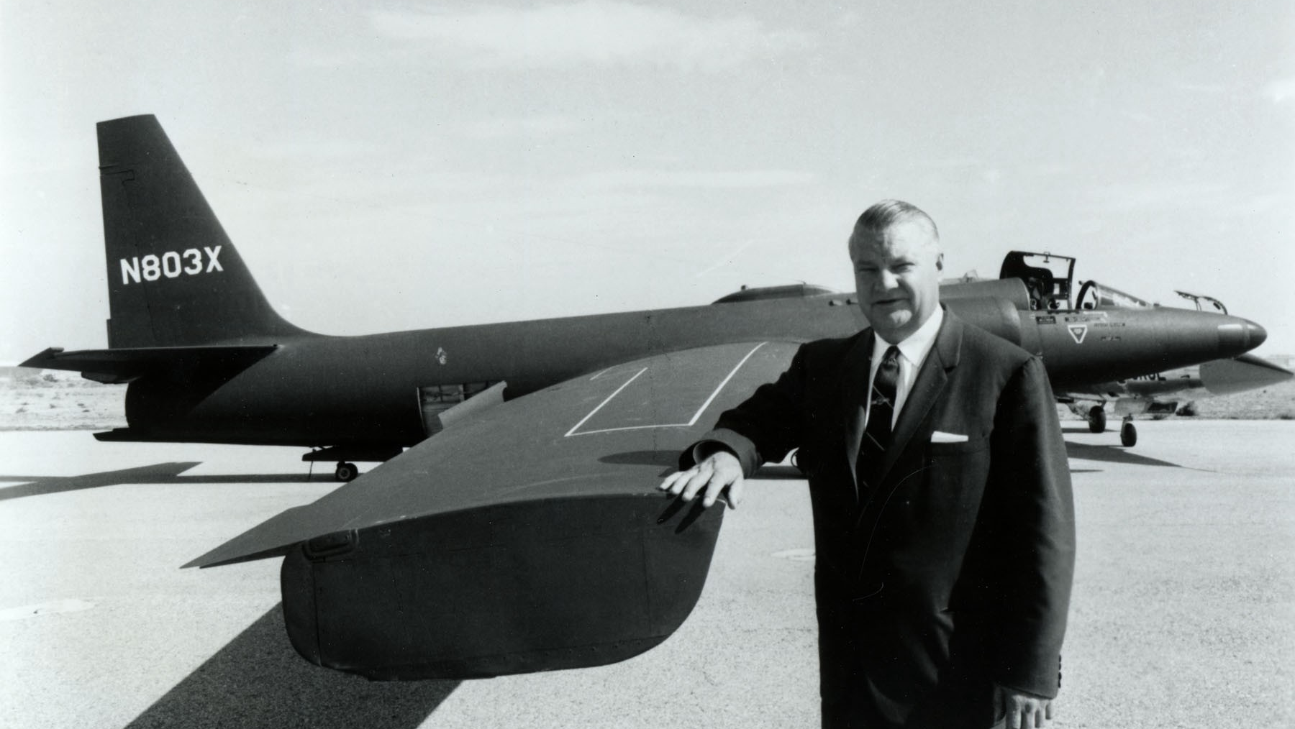
U-2 Spy Plane

Slide 61
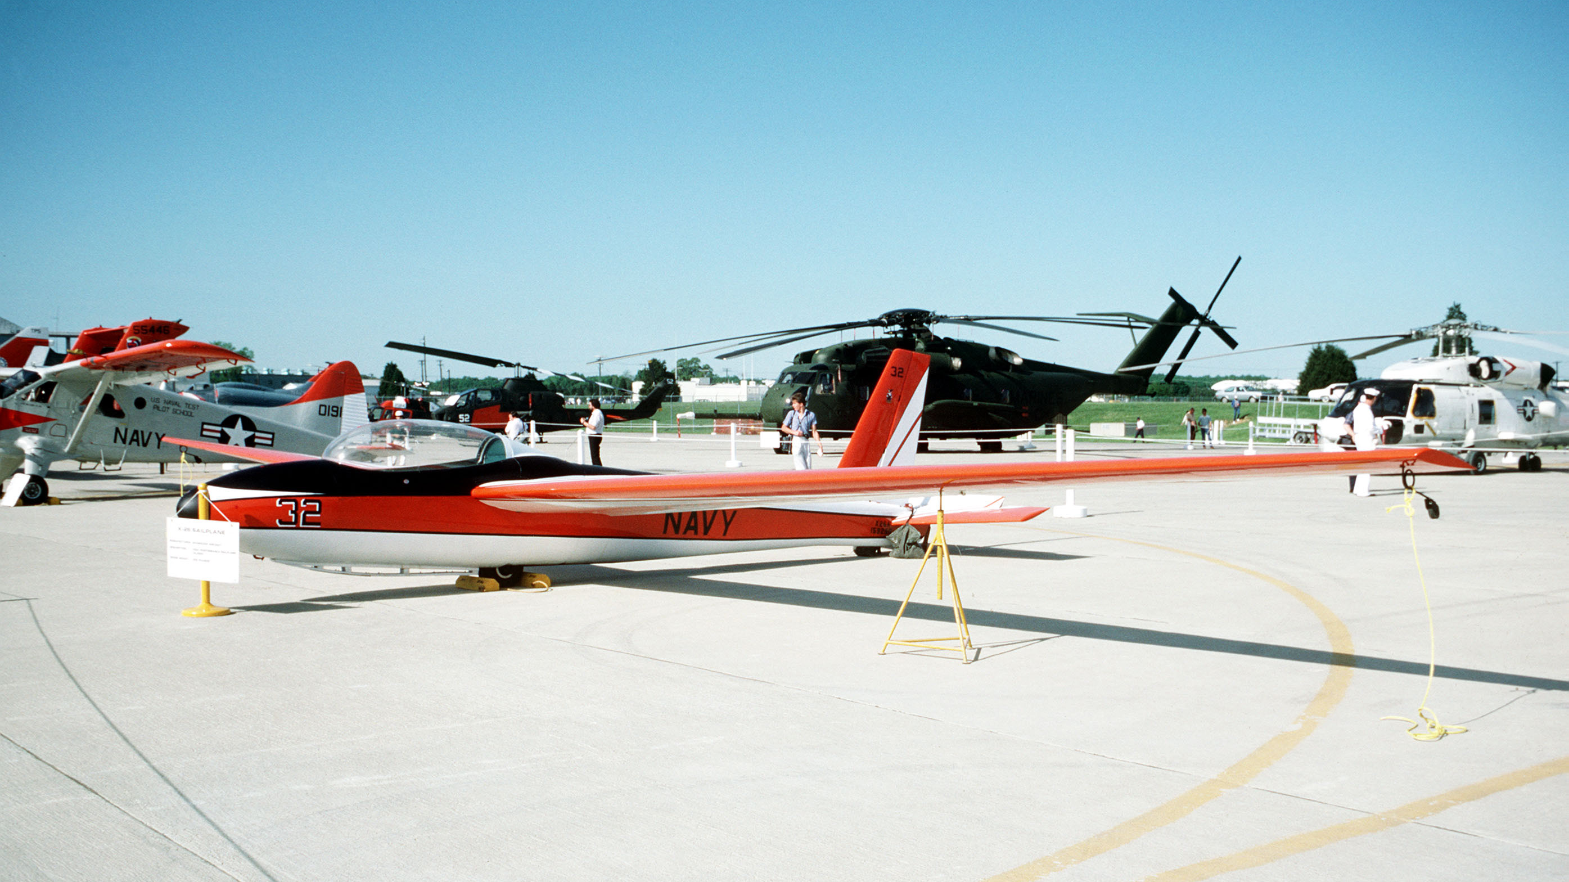
X-26 Sailplane

Slide 62
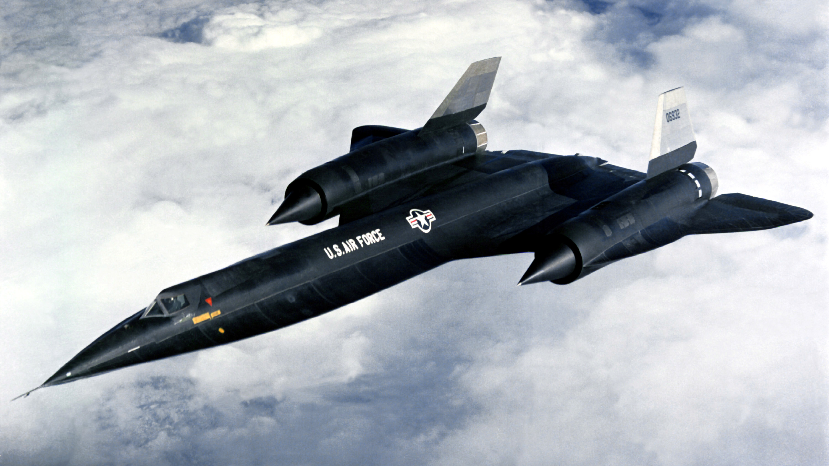
A-12

Slide 63
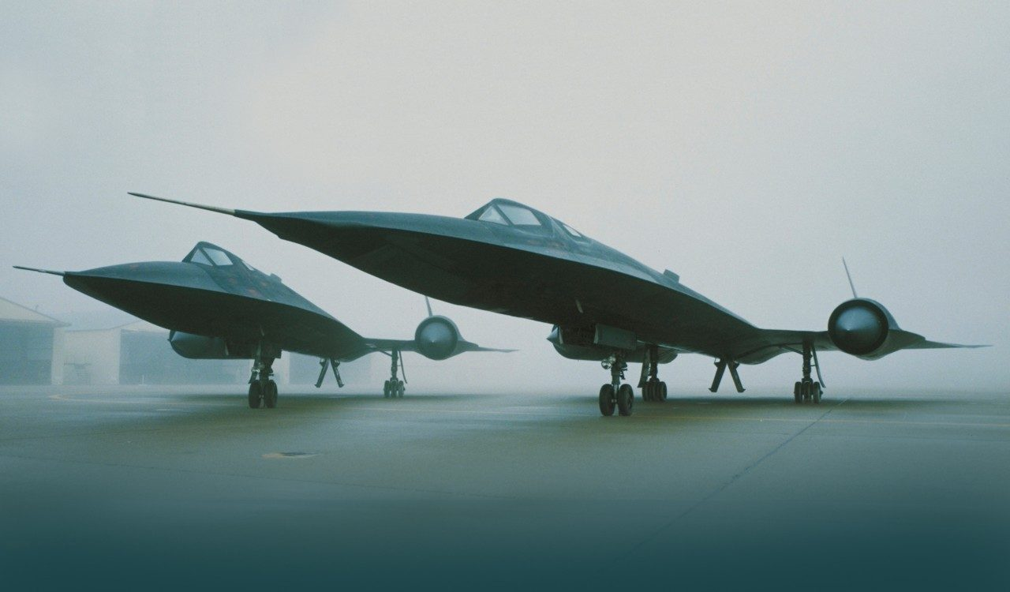
SR-71

Slide 64
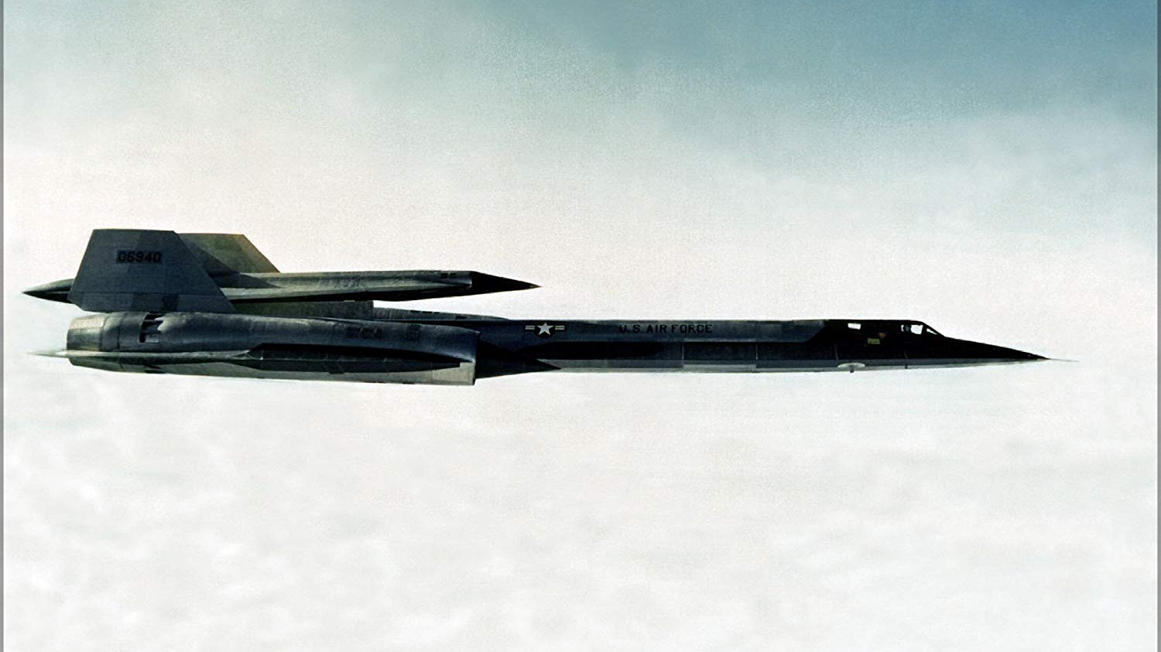
D-21 Surveillance Drone

Slide 65
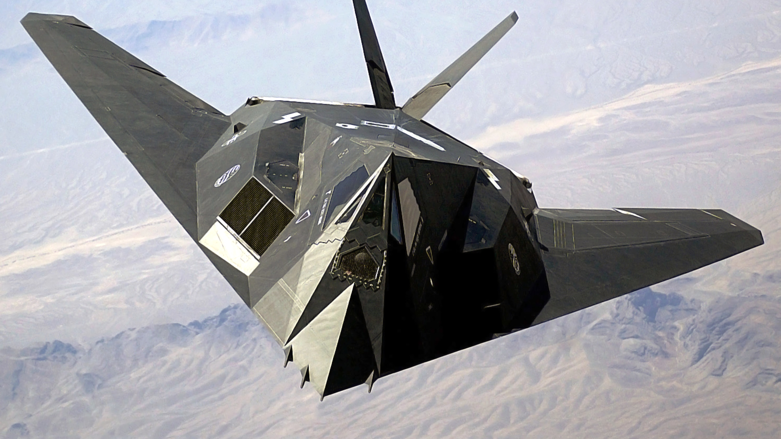
F-117 Nighthawk

Slide 66
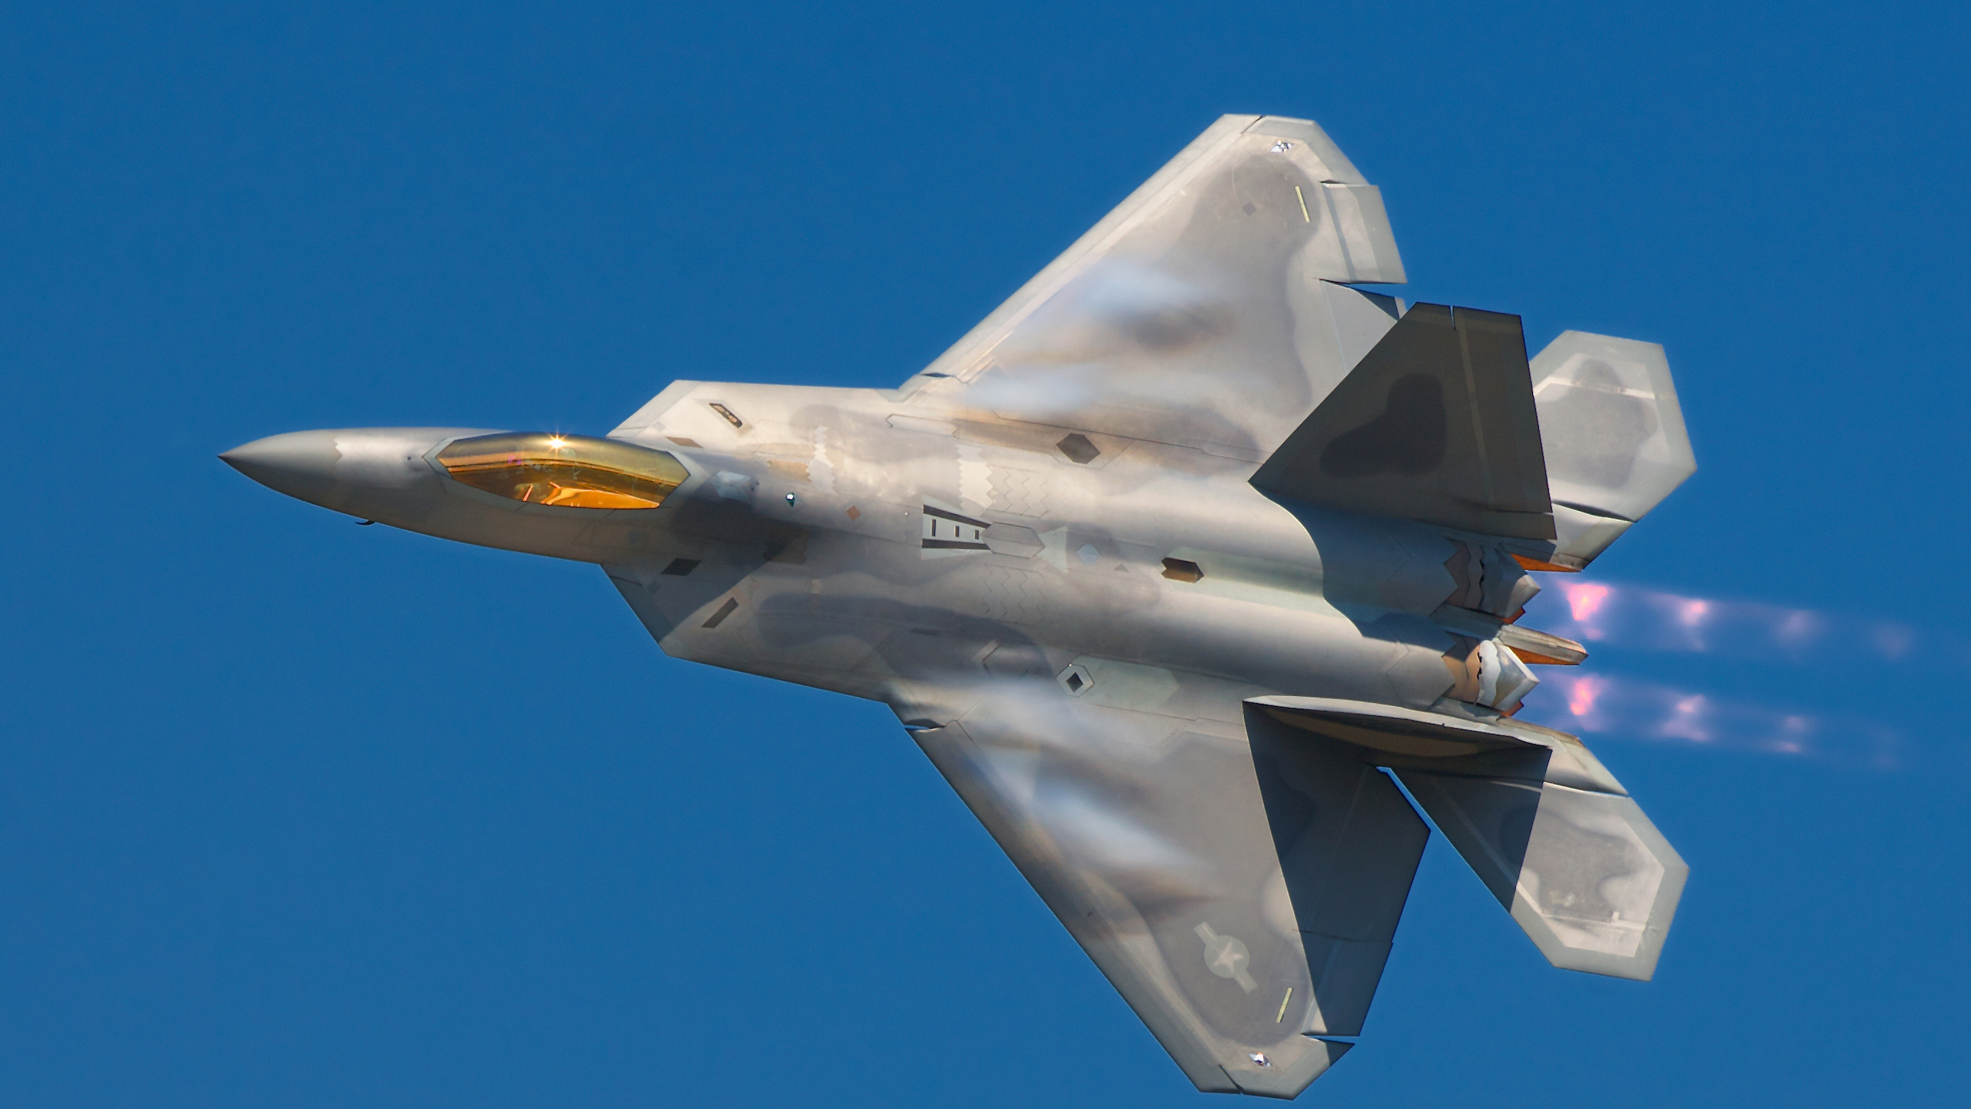
F-22 Raptor

Slide 67
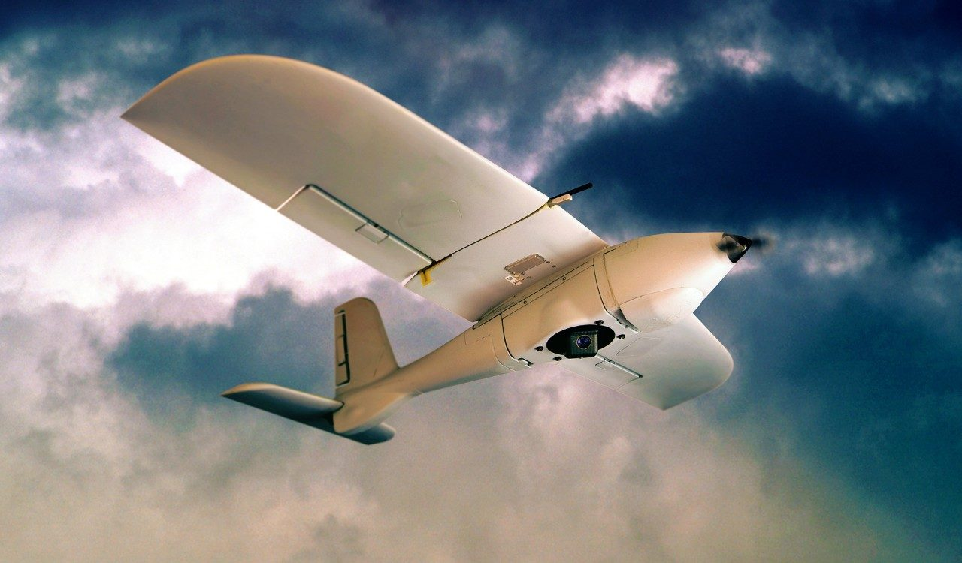
Desert Hawk

Slide 68
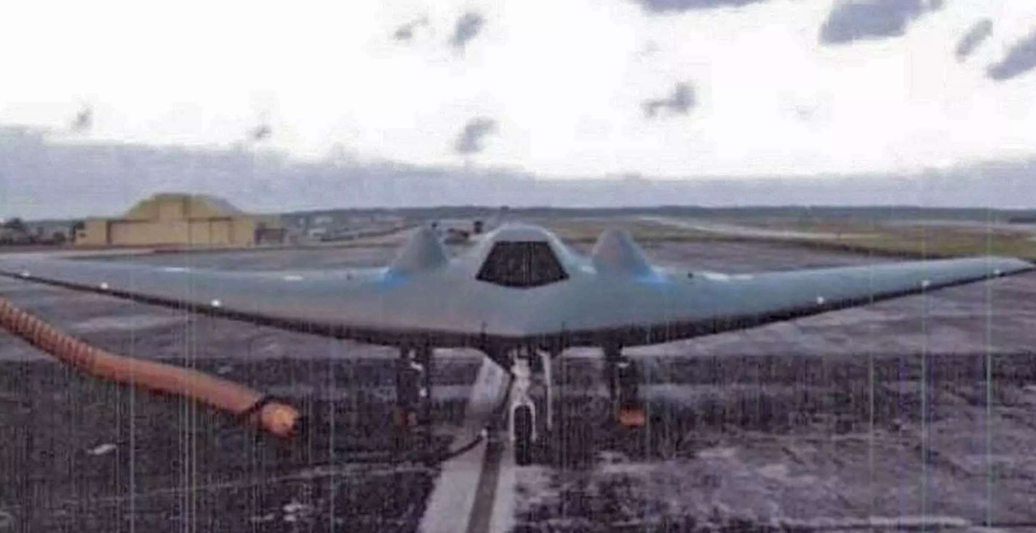
RQ-170 Sentinel

Slide 69
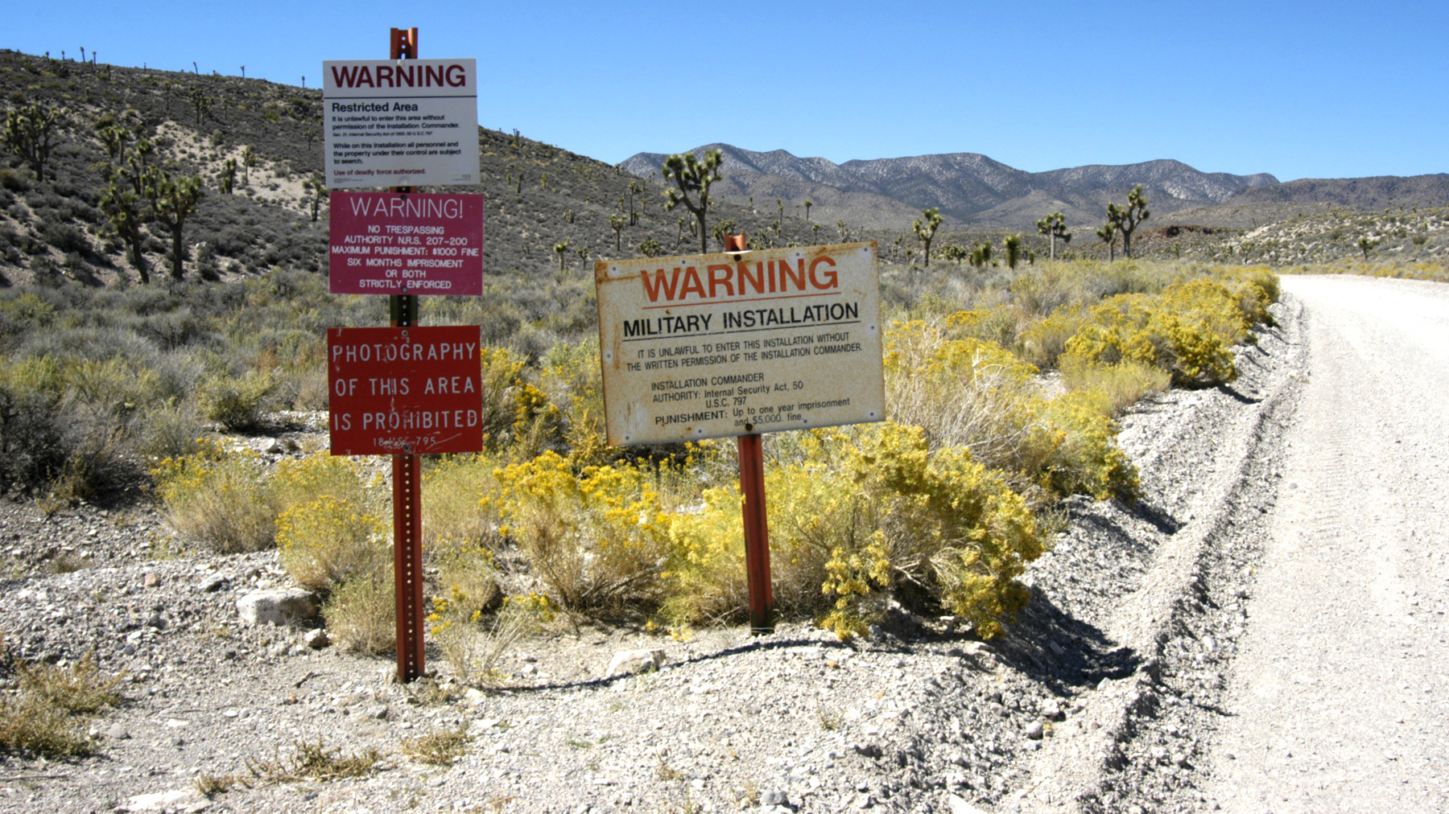
Area 51 and Many, Many Conspiracy Theories

Slide 70
A Little About Kelly Johnson
Astonishingly brilliant engineer
Brass-tacks management style
Often cited as the originator of “KISS”
Motto: “Be quick, be quiet, and be on time.”
Designed and saw to completion 19 families of aircraft
Recipient of 52 engineering, government, and civilian awards
For comparison, I’m pretty bright, and I’m at ZERO.
Founder and long-time director of the Skunk Works

Slide 71
Story of the P-80: Context
This is just one example, but it is the first example
In WWII, we needed to compete with Germany’s Me262
Lockheed already producing P-38, B-17, Hudson Bomber, Lodestar, and Venturas totaling 28 aircraft per day.
Everybody already working three shifts, 6 days per week.
Lots of work on Sundays, too.

Slide 72
Story of the P-80: Blockers
No spare engineers
No spare machinery
No available space
No engines
No time for prototyping
Etc…
They had blockers of every imaginable kind.
Thus, the scrum master was invented.

Slide 73
Story of the P-80: Outcome
Letter of intent signed on June 8, 1943
Johnson had 180 days to deliver
Anybody want to guess how long it took?
First flight on January 8, 1944
Aircraft flew 502 MPH.
That was day 143 of the project
Built a new, first-of-it’s-kind, jet fighter with 37 days to spare.
So… how did he do it?

Slide 74
Kelly’s Planned Work Environment
Set up an experimental department
Designers and top artisans working closely together
No delays or complications from intermediate departments handling
Administration
Purchasing
All other support functions
Direct relationships between
Design engineers
Mechanics
Manufacturing

Slide 75
Story of the P-80: Creating Space
There was no space to work
Built a temporary structure next to the wind tunnel. This was the only open space of any kind.
Built out of Wright engine boxes
And a rented circus tent
I can’t make this stuff up
No machine shop
Hijacked the machine shop next to the wind tunnel

Slide 76
Story of the P-80: Blockers and solutions
Not enough tools
Bought out a local machine shop
No Engineers
Stole them from other projects
No time for a bunch of red tape
Operated independently from the main plant

Slide 77
Story of the P-80: Blockers and solutions
No engine to build around
Built a wooden mockup
Engine expert arrested for jaywalking on arrival
AND super-duper secret engine just sitting around in a crate
Call the Air Corps to negotiate his release
No time to draw, prototype, and re-draw parts?
Prototype on the airframe itself, and embrace change.

Slide 78
Story of the P-80: Scheduling
Counted off days on a big scoreboard (sounds like a sprint to me)
Projected completion for each milestone tracked daily. Another word for this is a burndown.
10-hour, six day weeks
Absolutely no work on Sundays.
This schedule rigidly was enforced.
To prevent sickness
To prevent burnout

Slide 79
Aside: “Skunk Works,” the Name
What is Kelly working on? “Stirring up some kind of brew.”
This brought to mind Al Capp’s then current “’Lil Abner” and the hairy Indian’s brew named “Kickapoo Joy Juice.”
Ingredients: Old shoes, metal polish, railroad ties, hot peppers, and other unlikely materials.
Including skunks.

Slide 80
Story of the P-80: First Flight
Plane named Lulu-Belle
Milo Burcham (Long-lost relative. Probably) at the controls
Muroc Dry Lake (Now Edwards AFB)
Top speed: 502 MPH

Slide 81
Story of the P-80: Follow-up
Bigger engine, 80% bigger plane
Second prototype, mostly new, finished 132 days later
Armed
80 MPH faster
Forerunner of the F-80, T-33 trainer, and F-94
Named the Shooting Star
More than 6,000 built

Slide 82
Story of the P-80: Follow-up
Didn’t see action in WWII in numbers
Training against it helped develop tactics against the Me262
Long-time test pilot Milo Burcham died during testing
Since then, Lockheed aircraft always have standby fuel systems

Slide 83
Kelly Johnson’s 14 Rules
1. The Skunk Works manager must be delegated practically complete control of his program in all aspects. He should report to a division president or higher.
2. Strong but small project offices must be provided by both the military and industry.
3. The number of people having any connection with the project must be restricted in an almost vicious manner. Use a small number of good people (10% to 25% compared to the so-called normal systems)

Slide 84
Kelly Johnson’s 14 Rules
4. A very simple drawing and drawing release system with great flexibility for making changes must be provided.
5. There must be a minimum number of reports required, but important work must be recorded thoroughly.
6. There must be a monthly cost review covering not only what has been spent and committed but also projected costs to the conclusion of the program.

Slide 85
Kelly Johnson’s 14 Rules
7. The contractor must be delegated and must assume more than normal responsibility to get good vendor bids for subcontract on the project. Commercial bid procedures are very often better than military ones.
8. The inspection system as currently used by the Skunk Works, which has been approved by both the Air Force and Navy, meets the intent of existing military requirements and should be used on new projects. Push more basic inspection responsibility back to subcontractors and vendors. Don't duplicate so much inspection.

Slide 86
Kelly Johnson’s 14 Rules
9. The contractor must be delegated the authority to test his final product in flight. He can and must test it in the initial stages. If he doesn't, he rapidly loses his competency to design other vehicles.
10. The specifications applying to the hardware must be agreed to well in advance of contracting. The Skunk Works’ practice of having a specification section stating clearly which important military specification items will not knowingly be complied with and reasons therefore is highly recommended.

Slide 87
Kelly Johnson’s 14 Rules
11. Funding a program must be timely so that the contractor doesn't have to keep running to the bank to support government projects.
12. There must be mutual trust between the military project organization and the contractor, the very close cooperation and liaison on a day-to-day basis. This cuts down misunderstanding and correspondence to an absolute minimum.
13. Access by outsiders to the project and its personnel must be strictly controlled by appropriate security measures.

Slide 88
Kelly Johnson’s 14 Rules
14. Because only a few people will be used in engineering and most other areas, ways must be provided to reward good performance by pay not based on the number of personnel supervised.

Slide 89
Kelly Johnson’s 15th, Unwritten Rule
The most important rule ever expressed for coming in on time, and under budget.
Only ever spread by word of mouth.
“Starve before doing business with the damned Navy. They don't know what the hell they want and will drive you up a wall before they break either your heart or a more exposed part of your anatomy.”

Slide 90
References
Archangel: CIA's Supersonic A-12 Reconnaissance Aircraft by David Robarge, CIA Chief Historian
Flying the SR-71 Blackbird by Col. Richard H. Graham, USAF (ret.)
The Imagineers of War: The Untold Story of DARP, The Pentagon Agency That Changed The World by Sharon Weinberger
Kelly: More Than My Share of It All by Clarence L. "Kelly" Johnson (With Maggie Smith)
The Pentagon's Brain: An Uncensored History of DARPA, America's Top Secret Military Research Agency by Annie Jacobson
Note: Conspiracy Theory, but good information too.
Skunk Works: A Personal Memoir of My Years at Lockheed by Ben R. Rich (With Leo Janos)
SR-71: The Complete Illustrated History of The Blackbird, The World's Highest, Fastest Plane by Col. Richard H. Graham, USAF (ret.)

